Slide 1
What is
One Health?

Slide 2
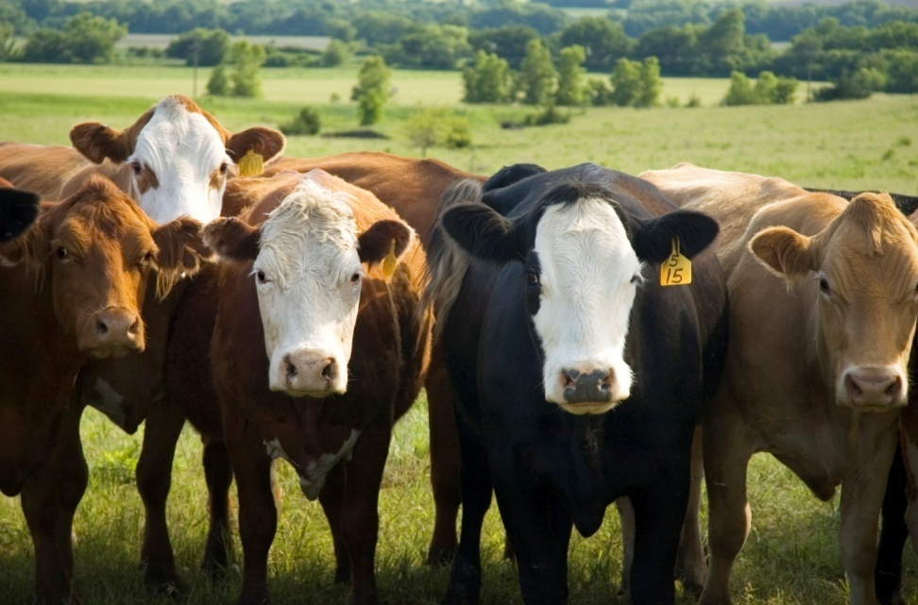
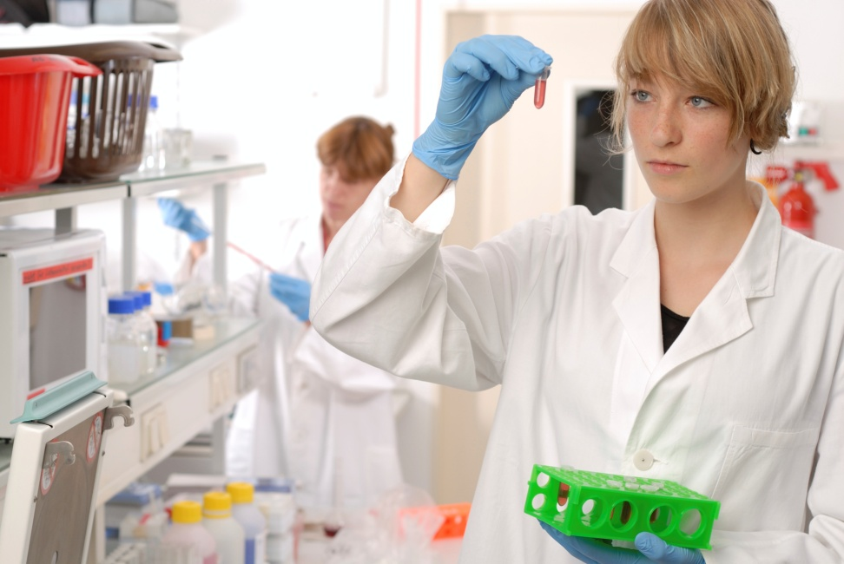
In One Health,
We study how animals, and people can live together in a healthy world.
Notes:
A. These cows may be a food source for many. If there were an outbreak of disease, we would want to contain and minimize the negative effects.
B. Tracing the food from source to table is an important step in being sure the food you eat is safe.
Take a moment to mentally list all the different steps needed to get lettuce for your salad from the field to your plate. (pause 15 seconds)
Harvester cuts lettuce from plant in crop field
Truck takes cut heads of lettuce to processing plant
Lettuce is washed, trimmed, packaged and stored for shipment. All steps along the processing plant are possible sites for contamination.
Truck delivers crates to grocery store. (Is it refrigerated?)
Produce worker uncrates and stocks lettuce on shelves in grocery store. (Did the stocker wash their hands and are they disease-free?)
You put lettuce in your shopping basket.(Someone else may have picked up your head of lettuce before you did.)
Cashier scans lettuce.
Packer puts lettuce in bag.
You come home and make your salad. (Even individually wrapped lettuce may have germs are left on the packaging. After you remove the lettuce from the packaging do you wash your lettuce with soap and water or a “vegetable wash” after you remove the packaging, and wash your hands again?

Slide 3
What is One Health?
The One Health Commission states that, “The One Health approach is a proactive, collaborative, and trans-disciplinary pathway to health and well-being.” This was not always the view….
Notes:
A. These cows may be a food source for many. If there were an outbreak of disease, we would want to contain and minimize the negative effects.
B. Tracing the food from source to table is an important step in being sure the food you eat is safe.
Take a moment to mentally list all the different steps needed to get lettuce for your salad from the field to your plate. (pause 15 seconds)
Harvester cuts lettuce from plant in crop field
Truck takes cut heads of lettuce to processing plant
Lettuce is washed, trimmed, packaged and stored for shipment. All steps along the processing plant are possible sites for contamination.
Truck delivers crates to grocery store. (Is it refrigerated?)
Produce worker uncrates and stocks lettuce on shelves in grocery store. (Did the stocker wash their hands and are they disease-free?)
You put lettuce in your shopping basket.(Someone else may have picked up your head of lettuce before you did.)
Cashier scans lettuce.
Packer puts lettuce in bag.
You come home and make your salad. (Even individually wrapped lettuce may have germs are left on the packaging. After you remove the lettuce from the packaging do you wash your lettuce with soap and water or a “vegetable wash” after you remove the packaging, and wash your hands again?

Slide 4
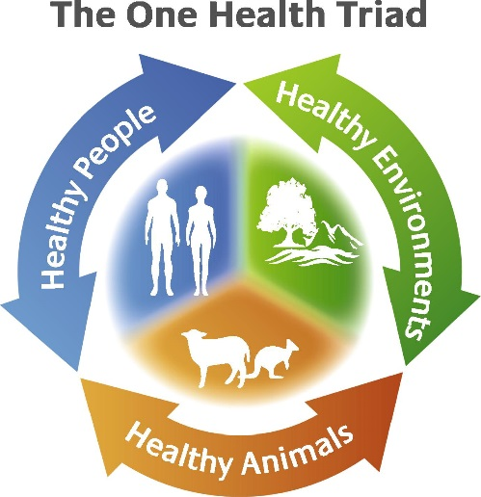

One Health: The Historical Perspective-why is this still an issue?
(Cursor over black box to activate 6 min. video)
Notes:
Insert info into this PowerPoint from video. Outline timeline of One Health development as two column notes….
1879-Trade disputes between U.S.(economically dependent on animal meat exports) and Britain
1. Dispute primarily due to two reasons
A. Contagious bovine pleural pneumonia (cattle)
B. Trichinosis (swine)
2. Letter sent from Hon. Johnston to U.S. Surgeon General included an argument from Dr. Jon Shaw Billings:
a. When diseases of animals interfere with safe food consumption by humans, it should be regulated.

Slide 5
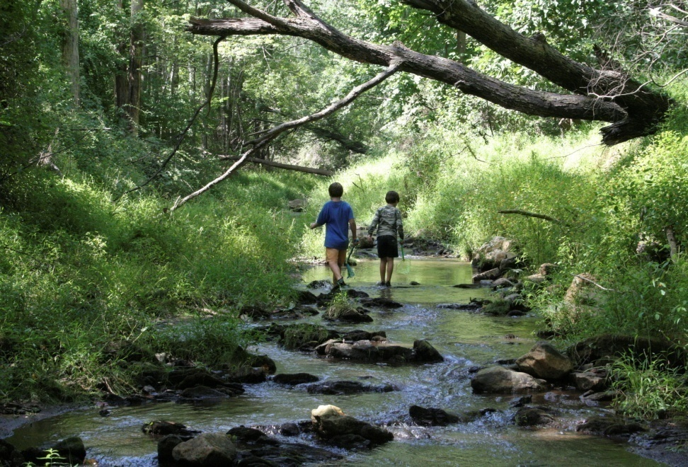
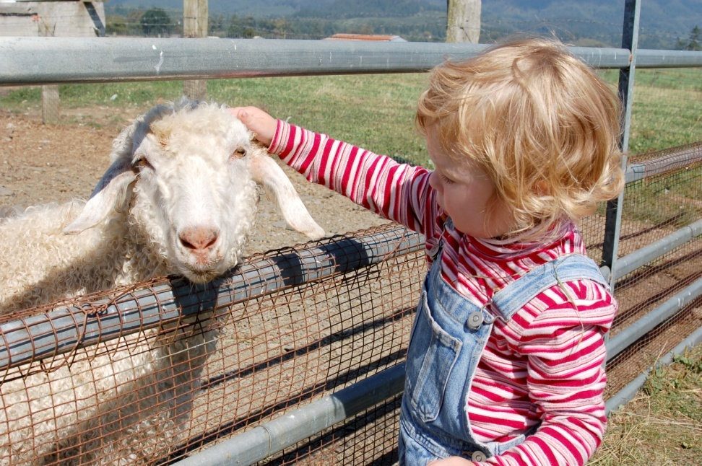

Living together in our environment in a healthy way is sometimes a challenge.
Notes:
The environment has freely moving air and water. What is in one water source becomes part of all water sources because of the water cycle. Water picks up dissolved particles in the soil and carries it from one place to another, particularly during storm events when extra water falling as rain can contaminate our source of drinking water.
The human animal bond is a strong one. However, when we interact with animals and other people, we share good memories and hugs.
We might also share germs or chemicals that sometimes make us sick.

Slide 6

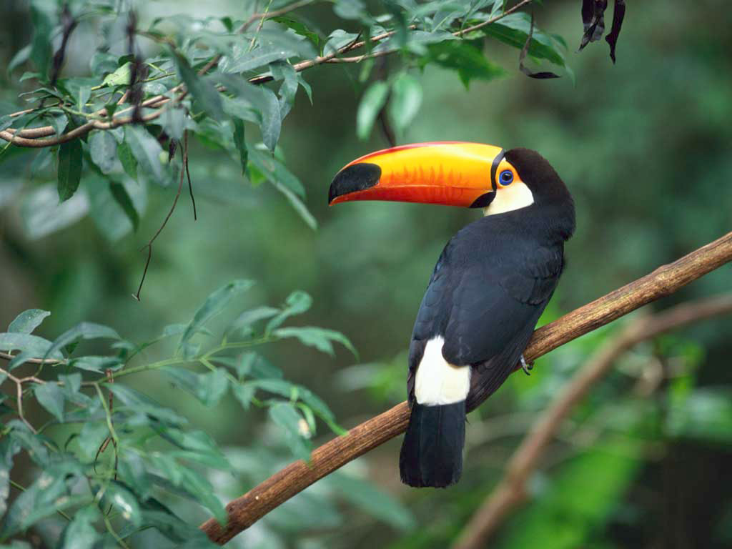
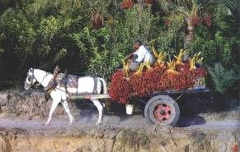

Global Trade & Travel
Food, people and diseases travel
quickly around the world.
Notes:
At One Health, we look at global trade and travel.
Not all our food is local. When our food and drink is not raised locally, it is shipped from other parts of the U.S. , and the world.
Where do we buy our grapes or apples in winter?
Do you think you or your parents could face the day without morning coffee? Coffee is usually shipped year round from a country outside the U.S.
Photo credits: Windows sample pictures, Joni Teeter, USEPA Region 8
Exotic pets, global trade, travel; diseases transmitted over a wider area with greater speed

Slide 7
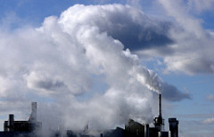
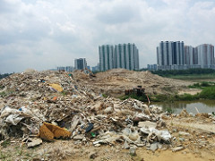


Environmental health impacts human health
http://www.unmultimedia.org/photo/
Air Quality
Water Quality
Solid waste issues
Food safety
https://creativecommons.org/licenses/by/2.0/
https://www.flickr.com/photos/usepagov/
Notes:
Air Quality-Car and industry emission standards established by the govt. must be monitored. We have to be made aware of indoor pollutants which affect our health. Old buildings go through renovations to remove asbestos, and defective ventilation systems.
Water quality- the water we drink, and the water we play in, are tested to keep us safe, and agencies warn us of risks, should any arise.
Solid waste-After our trash is picked up at our house, it is important that wastes not leak into water sources. The city, and state agencies help keep us safe.
Food safety- Our Govt. inspects foods, and establishes food safety standards. One Health Kansas educates the public about health risks.

Slide 8
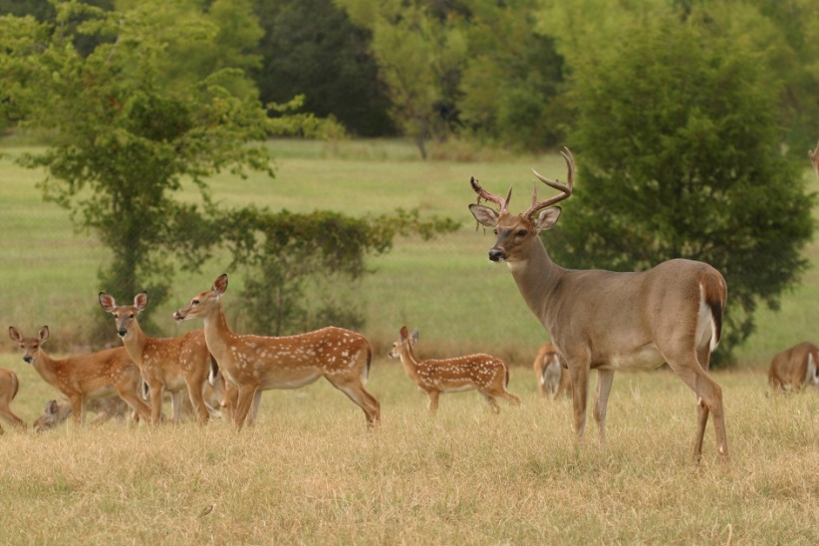
At One Health we look at:
Human-animal bond
Disaster response
Zoonotic disease
Foodborne illness
Animal bites and prevention
Environmental impacts

Slide 9
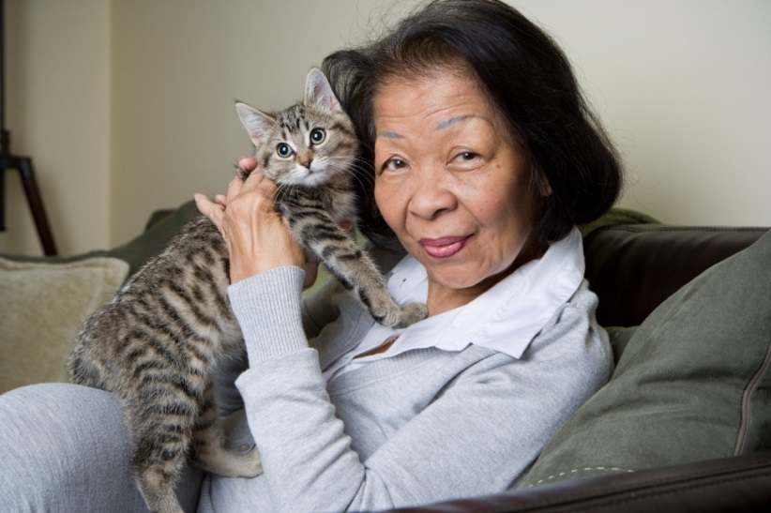
The Animal-Human Bond
Improved emotional health
Increased physical activity
Fewer doctor visits
Opportunity to explore translational and comparative medicine, i.e., chemotherapy & drug treatments for dogs is improving human cancer experience.
Lessons learned:
  Hurricane Katrina
  Greensburg
  Kansas State Animal Response Team www.kssart.org
  National Animal Disease Response http://bit.ly/1OZKWsH
Notes:
Pets make all our lives richer, better.
When our pets need a walk, we exercise too.
Sometimes pets can lower blood pressure(maybe it’s because we’re exercising more). Many owners state that their pets have a calming influence.
Service animals can be trained to help people who are disabled live more independently.
When we are separated from our pets by natural disaster(like flood, tornado, hurricane) KSSART is an organization that helps locate and reunite us with our pets.

Slide 10
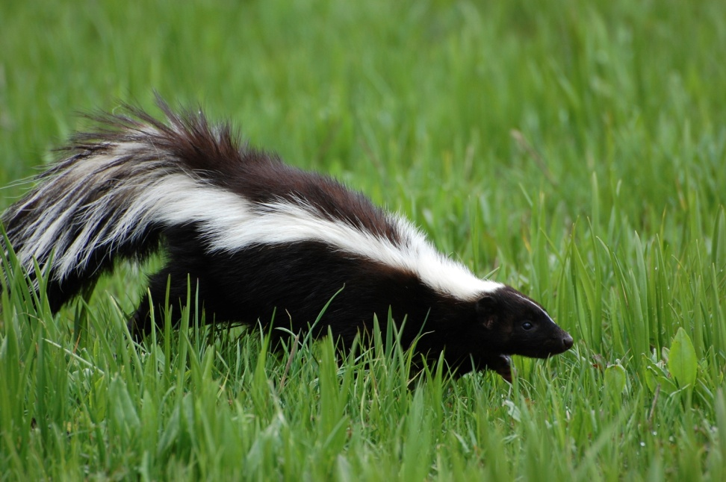
One Health Explores Zoonotic Diseases like those listed below:
Rabies
West Nile Virus
Rocky Mountain Spotted Fever
Salmonella
Giardia
Notes:
Some diseases give us symptoms quickly, like having diarrhea or vomiting every 15 minutes. You could have an upset stomach within an hour of eating contaminated food. Other diseases can make us run a fever, or cause nerve or brain damage.
One Health tries to help us understand how to be outdoors without having animals give us disease.
Some suggestions are:
Never try to pick up or pet a wild animal.
Apply bug spray when you are outdoors.
Bring your own drink to a picnic or hike(never share a drink with a friend), and don’t drink from lakes or rivers, no matter how clear and clean the water looks.

Slide 11
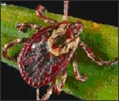
So, what exactly is a zoonotic disease?
Zoonotic diseases are diseases that can be transmitted from animals to humans
61% of all human diseases are zoonotic!
Notes:
(Wait for animation to reveal definition!!)
Large groups will not be conducive to this, but could hand out the list of zoonotic diseases and bring textbook of Human Animal Medicine-DON’TLOSE!!!

Slide 12
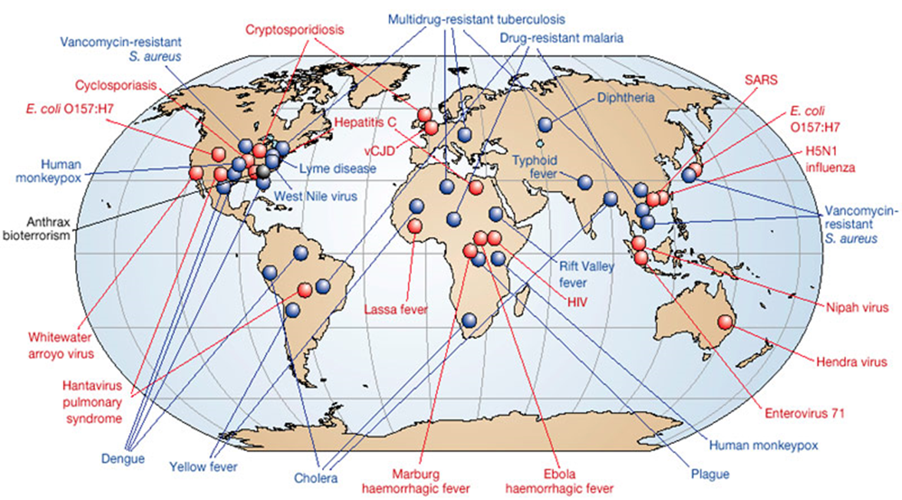
Emerging Diseases
60% of diseases currently recognized in humans are due to pathogens that affect multiple species
Approximately, 75% of emerging human infectious diseases are diseases of animal origin
Source: NATURE; Vol 430; July 2004 www.nature.com/nature
Notes:
https://www.onehealthcommission.org/en/fast_facts/
The recent increase of emerging and reemerging zoonotic diseases that affect both humans and animals has caused an increase in the need for communication and education about the One Health concept at all levels in academia.

Slide 13
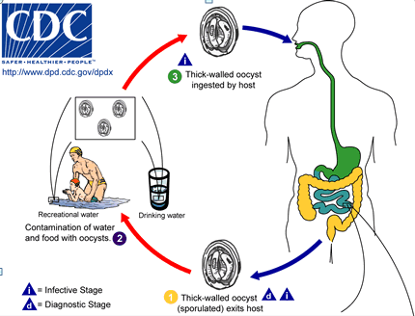
Anthroponotic diseases are diseases that are transmitted from humans to animals (i.e.,Giardia, parasitic worms Cryptosporidium),and possibly back into a human again.

Slide 14
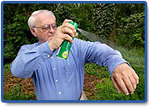
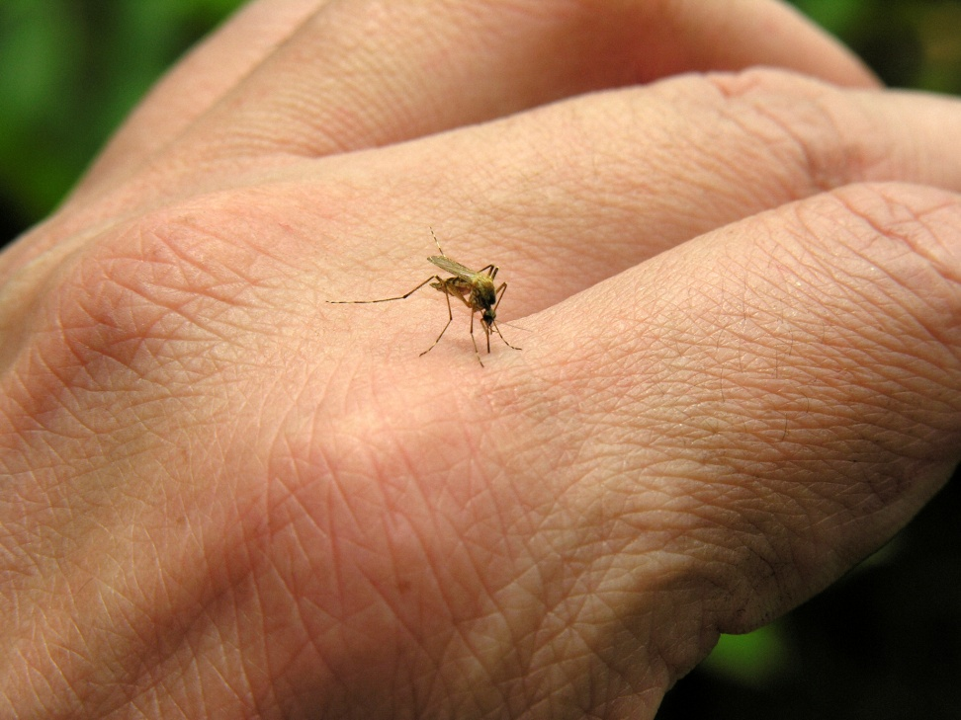
Zoonotic Disease Prevention: Vector Control
Vectorborne illness
West Nile Virus (mosquito)
Rocky Mountain Spotted Fever (tick)
Lyme Disease (tick)
Control measures
Interrupt insect life cycle
ID insect habitats, & remove standing water to prevent mosquito breeding grounds(tip & dump)
Apply insecticide to breeding areas (or self, when going outside).
Notes:
When I take my horse to horse shows, I am required to have a Health certificate and up-to-date vaccinations through which any state I travel.

Slide 15
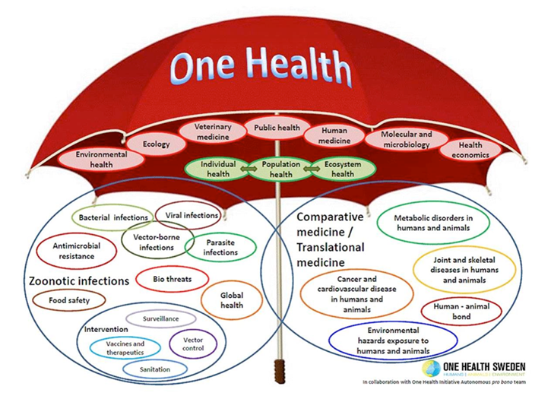
Notes:
One Health offers many links with existing careers. Please study the umbrella. You’ll be challenged to match 7 pictures in the next slide to the various parts. I’ll flip back and forth and allow you time to figure it out.

Slide 16
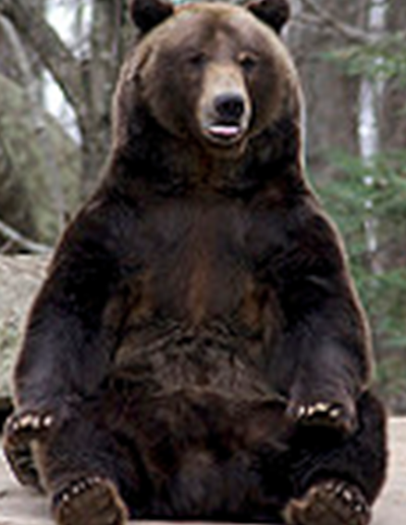
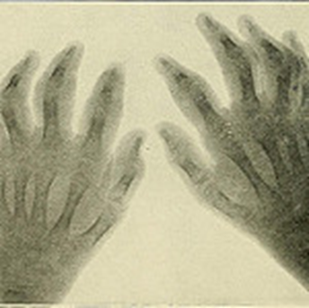
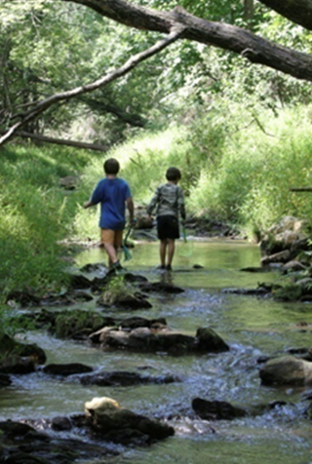
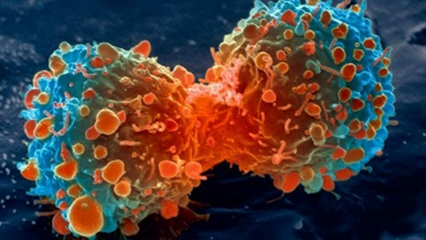
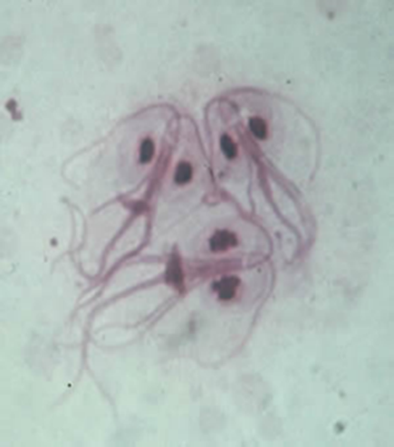

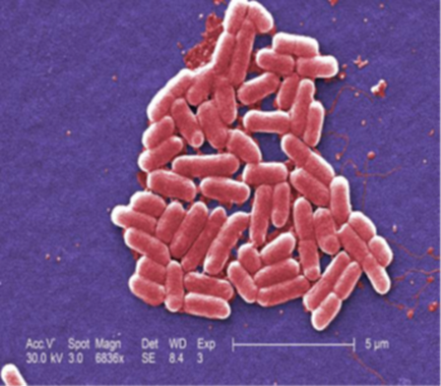
Where would these pictures fit into the One Health umbrella graphic?
Notes:
(Click back and forth from previous umbrella slide)

Slide 17


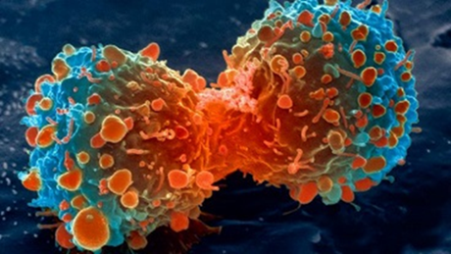

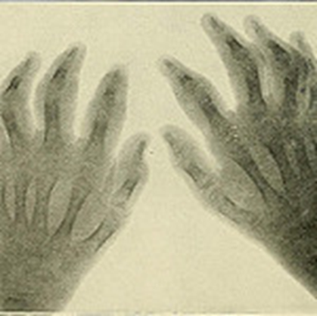
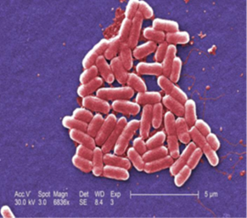
Notes:
(Start umbrella with click) Animals can struggle with Metabolic disorders just like humans do.
Arthritis affects both humans and animals and can reduce joy in life.
We should enjoy an active lifestyle that includes exercise outdoors in a healthy environment.
E. coli can be a serious threat, but proper food preparation can reduce that threat.
Ticks can transmit Lyme, among other diseases, and is one that has affected 4 people I know personally.
Giardia is a waterborne parasite in untreated water.
This virus is a cancer cell that can be found in dogs and humans.

Slide 18

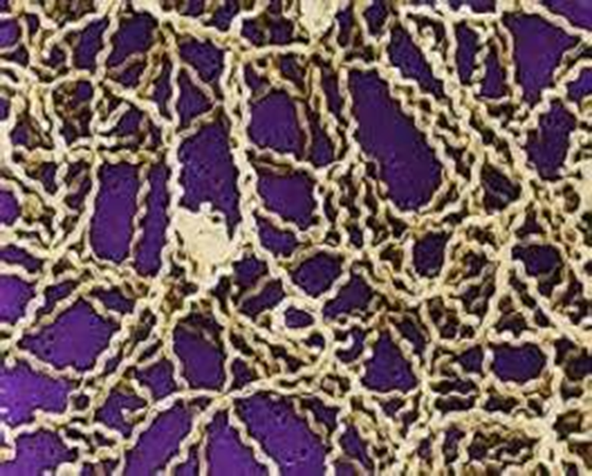
Four pathogens that contaminate water through animal feces or urine are:
(3) E. coli- causes E. coli infection
(1) Giardia
(4) Leptospira
(2) Salmonella
Notes:
(Skip notes for this page. Details follow on upcoming slides) Giardia- usually a problem where humans and wildlife use the same water source. May be through untreated water, poor disinfection, pipe breaks, leaks, or groundwater contamination.
(2) Salmonella- Although more common as a foodborne illness, Salmonella can be a water contaminant (causes Salmonellosis).
(3) E. coli- Like Giardia, E. coli is a problem where humans and wildlife use the same water source. May be through untreated water, poor disinfection, pipe breaks, leaks, or groundwater contamination.

Slide 19
All four of the pathogens shown in the previous slide cause:
A change in microbe populations(Some
double every 20 minutes, and all it takes is ONE, as it divides asexually)….
….and are sometimes followed by other more serious symptoms
Notes:
1. a change in microbe populations in the intestines which is marked first by gastrointestinal distress. This is because of something called competitive exclusion, and is where the unwanted microbe becomes so populous that it causes the other, helpful gut bacteria to die off.
2. sometimes followed by other more serious symptoms, such as major organ failure.

Slide 20
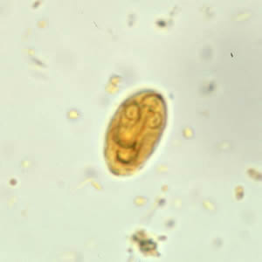

Giardia
Both animals and humans become infected with Giardia by swallowing Giardia cysts.
Giardia is protected by an outer shell that allows it to survive outside the body for long periods of time and makes it tolerant to chlorine, so it may not get killed
Notes:
People have become infected with Giardia by drinking from untreated water, or from unintentionally swallowing water in recreational water.
The photo on the left is of a Giardia cyst, while the one on the right is of a Trophozoite. Giardia is protected by an outer shell that allows it to survive outside the body for long periods of time and makes it tolerant to chlorine disinfection.

Slide 21
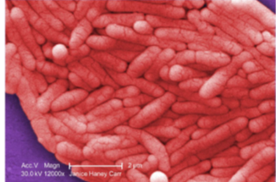
Salmonella
Salmonella gastrointestinal infections usually resolve in 5-7 days and most do not require treatment other than replacing fluids orally
In severe cases: prolonged diarrhea, high fever, bloodstream infection, esp. affects those who are immunocompromised
Notes:
Salmonella gastrointestinal infections usually resolve in 5-7 days and most do not require treatment other than oral fluids.
However, persons with severe diarrhea may require hospitalization and rehydration with intravenous fluids.
In severe cases: prolonged diarrhea, high fever, bloodstream infection, esp. affects those who are immunocompromised, very young, or elder individuals.

Slide 22
Escherichia coli
(E. coli)
bacteria that normally live in the intestines of people and animals
most are harmless and actually are an important part of a healthy human intestinal tract where they make Vitamin K, which is necessary for clotting the blood
Symptoms: Watery or bloody diarrhea, abdominal cramps, with or without fever
Notes:
(E. coli) These bacteria normally live in the intestines of people and animals.
Most E. coli are harmless and actually are an important part of a healthy human intestinal tract.
*humans can only live 3 months without E. coli in their intestines.
*E. coli help the body make Vitamin K, which is important for platelet production. Without platelets, the blood will not clot effectively, and bleeding to death is possible.
However, some E. coli are pathogenic, meaning they can cause illness, either diarrhea or illness when located outside of the intestinal tract.

Slide 23

Leptospira
Bacteria enter the body through skin or mucous membranes (eyes, nose, or mouth), especially if the skin is broken from a cut or scratch
Outbreaks of Leptospirosis usually occur during spring floods…..WHY?
Notes:
Bacteria enter the body through skin or mucous membranes (eyes, nose, or mouth), especially if the skin is broken from a cut or scratch.
Recreational swimming in contaminated water can result in infection.
Drinking contaminated water can also cause infection.
…..Allow students to ponder the question posed….
(Outbreaks of Leptospirosis are usually caused by exposure to contaminated water, such as floodwaters. Person to person transmission is rare.)

Slide 24
Sources
Centers for Disease Control and Prevention: http://www.cdc.gov/ncezid/
One Health: http://www.onehealthinitiative.com/about.php
Conti, Lisa and Rabinowitz, Peter (2010) Human-Animal Medicine. Maryland Heights, Missouri: Elsevier
Notes:
These are the sources I used for the preceding slides.

Slide 25
Kinesthetic Voting Activity
Everyone stand up and stretch
Procedure for active voting…..

Slide 26
Question #1:
(Everyone stay standing, until the letter you are voting for is read)
On average, which percent of the U.S. population is affected by foodborne illness every year?
5% (sit down if you think it is 5%)
17 % (sit down if you think it is 5% or 17%)
33 % (sit, if you think it is 33% or less)
Over 50% (everybody should now be seated)

Slide 27
Answer to Question #1:
On average, of how many are affected by foodborne illness
every year in the U.S.?
5%
17 %
33 %
Over 50%

Slide 28
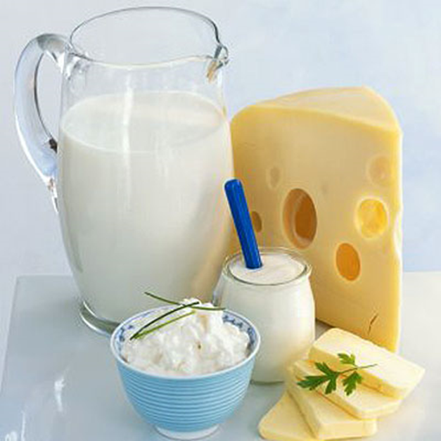
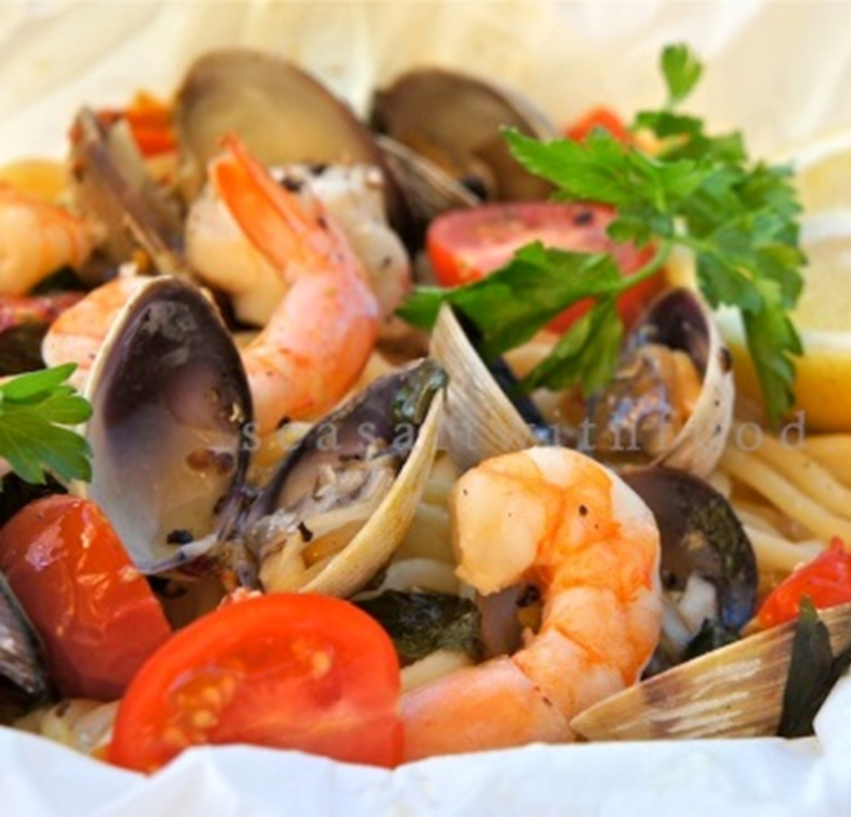
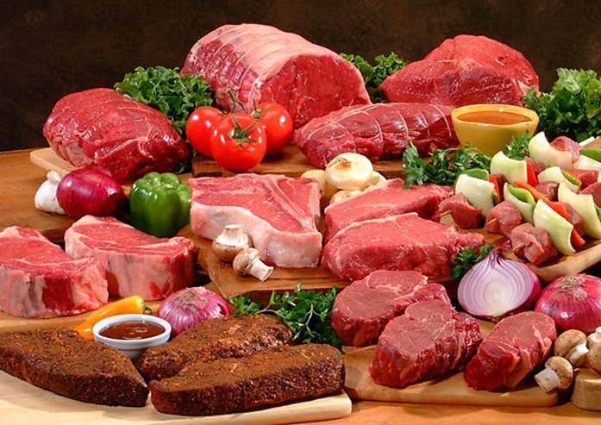
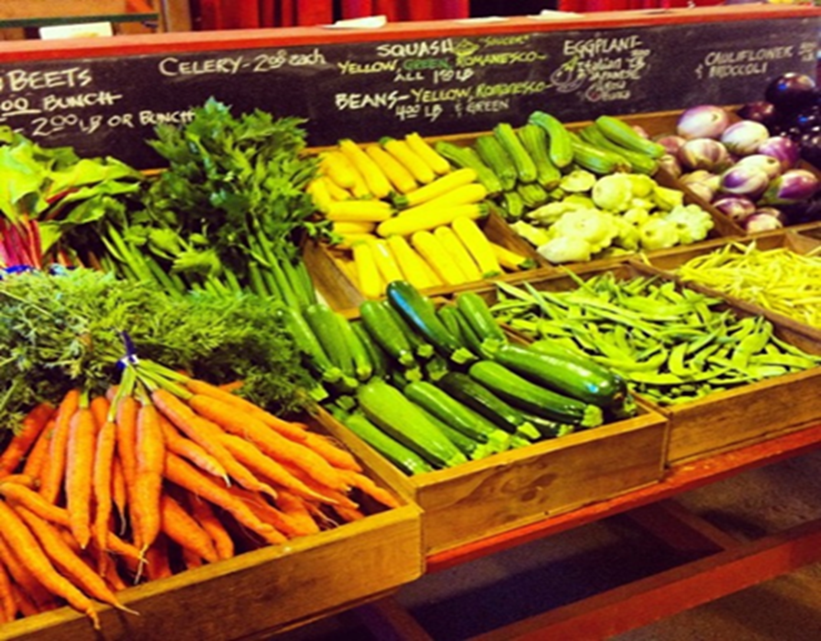
Question #2
(Once again, everyone stand up, then sit down as your letter is read) Of the following categories of food, which one is the main cause of illness in the U.S. every year?
Dairy and Eggs
Seafood and shellfish
Meat and poultry
Fresh produce

Slide 29
Answer to Question #2
Of the following categories of food, which one is the main cause of illness in the U.S. every year?
Dairy and Eggs
Seafood and shellfish
Meat and poultry
Fresh produce

Slide 30
Question #3
(Once again, everyone stand up, then sit down as your letter is read) Of the following categories of food, which one is the main cause of death in the U.S. every year?
Dairy and Eggs
Seafood and shellfish
Meat and poultry
Fresh produce

Slide 31
Answer to Question #3:
Of the following categories of food, which one is the main cause of death in the U.S. every year?
Dairy and Eggs
Seafood and shellfish
Meat and poultry
Fresh produce

Slide 32
The Kinesthetic Voting Activity is over ….
everyone needs to have a seat.
😊

Slide 33
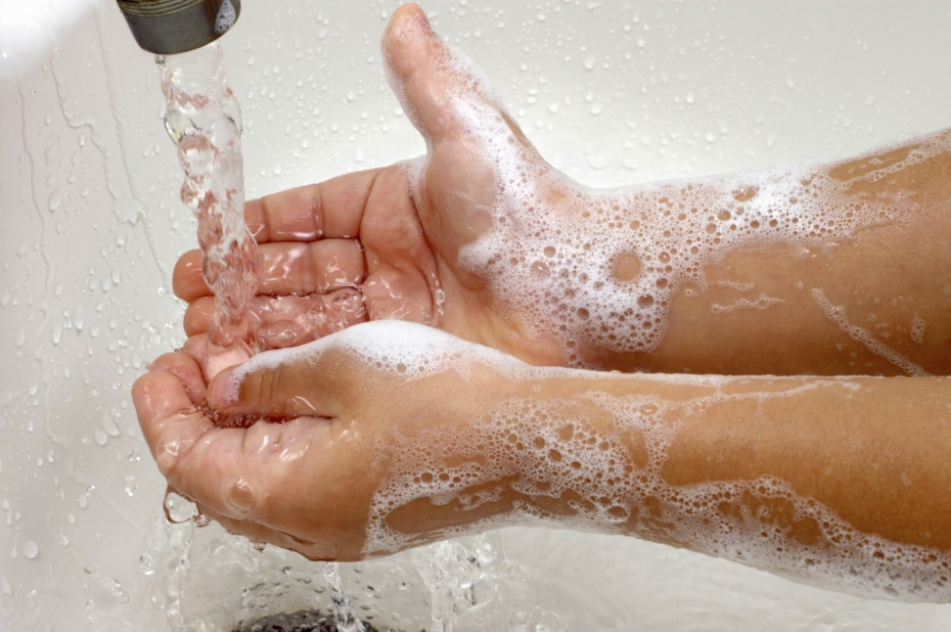
Zoonotic Disease Prevention:
Number One Prevention Measure
Wash hands
Before eating or cooking(even between steps of cooking)
After going to the bathroom
After petting animals
Notes:
Most hand sanitizers are good when you cannot wash hands with soap and water, but not in preventing the spread of Norovirus, a type of flu, or in killing bacterial spores or protozoan cysts.
Antibacterial soaps are being criticized by many health professionals. The ingredients may just make bacteria stronger, and promote bacterial resistance to antibiotics.
Doctors used to routinely prescribe antibiotics to patients just in case an illness was bacterial.
Now, doctors check to see if the illness is viral, and should just be allowed to run its course.
This lowers the amount of antibiotics in the environment to a minimum, and possibly reduce the chances of a bacteria developing an antibiotic resistance.

Slide 34
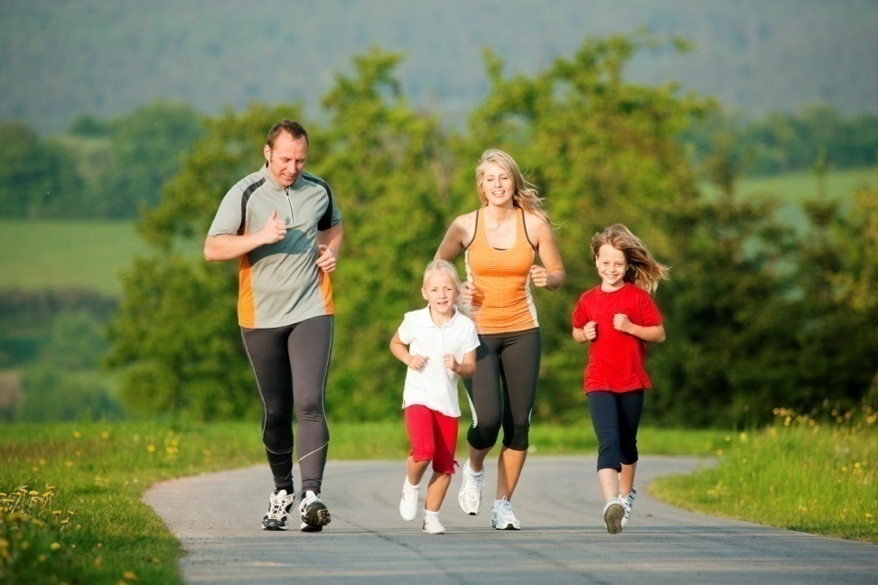
Cities, states, and the nation work together for
Better Public Health and Urban Planning
Walkable Communities
Built Environment
Community Gardens
Physical Activity
Nutrition
Health and wellness Education
Notes:
Walkable communities-encourage us to walk and bike rather than use cars.
Built environment-The physical layout of our cities with buildings can encourage us to have a healthy lifestyle.
Community gardens-help us help us look at food personally, and decide whether we want to add bug sprays or other chemicals to our foods.
Physical activity-One Health encourages people to get plenty of exercise to increase your heart rate and stay healthy.
Nutrition-Read the labels and choose what foods and drink are best for you.

Slide 35
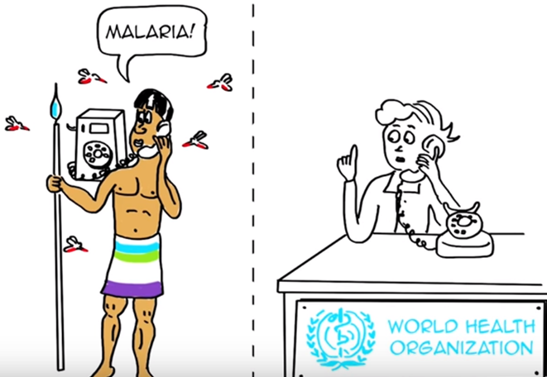
What happened when humans did not consider the One Health concept in Borneo?
https://www.youtube.com/watch?v=17BP9n6g1F0

Slide 36
If this presentation has you intrigued,
You may want to consider a career in the One Health field…

Slide 37
Careers in Public Health
Health Administration-business and management skills
Epidemiology & statistics-Math & Modeling skills
Health Education-develop community-wide programs
Environmental Health-Includes critical thinking skills
Health Policy-understanding of law-making processes
Source: http://www.whatispublichealth.org/careers/

Slide 38
Careers in Food Safety
Director of Food Safety/ Compliance
Food Inspector
Food Safety Sanitation Technical Specialist
Laboratory Analyst
Supervisory/Veterinary Medical Officer

Slide 39
Careers in Public Health Nutrition
Supervisory Public Health Nutritionist
Family Health Nutritionist
Extension Agent in Nutrition
Registered Dietitian
Assistant Public Health Nursing Chief
Clinical Nutritionist
Nutrition Program Director
Notes:
http://www.whatispublichealth.org/careers/pfizerguide/nutritionist.pdf
http://www.utexas.edu/lbj/sites/default/files/file/careers/APSIA%20-%20PUBLIC%20HEALTH%20&%20NUTRITION.pdf

Slide 40

One Health
Connecting people, animals and their environment through research-informed education
Creating a pipeline of health professionals to meet the need
  K-12 Education and Outreach
  Pathways to Public Health
  Workforce Development
  Infection Prevention
  Translational & Comparative Medicine

Slide 41
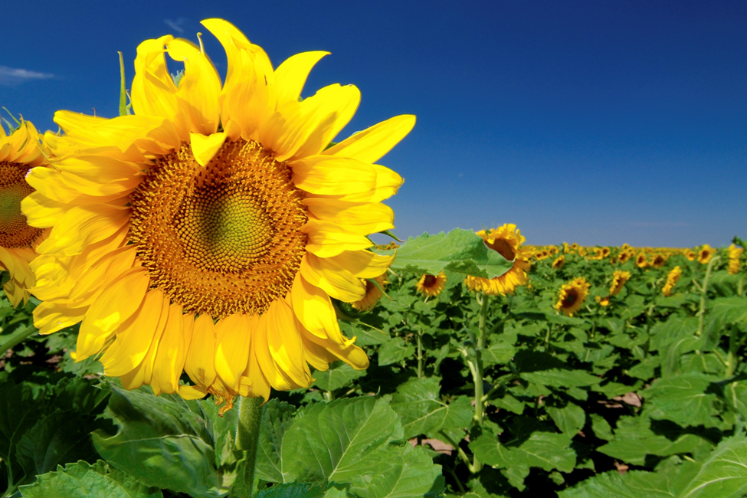
Questions?
Martha Nowak, M.Ed.
K-12 Engagement Coordinator/K-State Olathe
22201 W. Innovation Drive
Olathe, KS 66061
913/307-7321
msnowak@ksu.edu
Notes:
Give educationplanner.org website for career exploration

