Slide 1
What is
One Health?

Slide 2
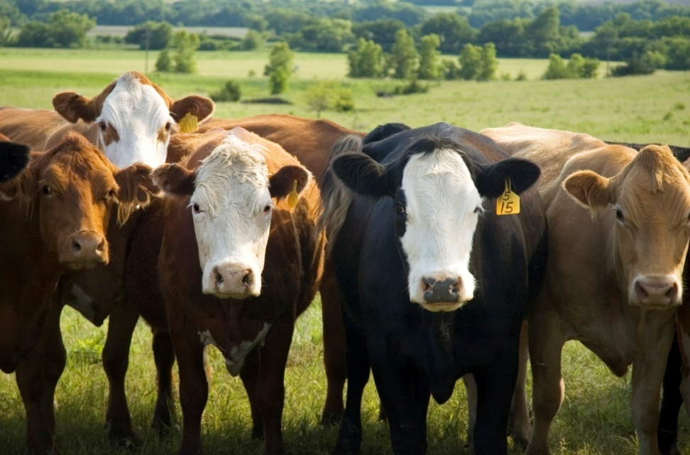
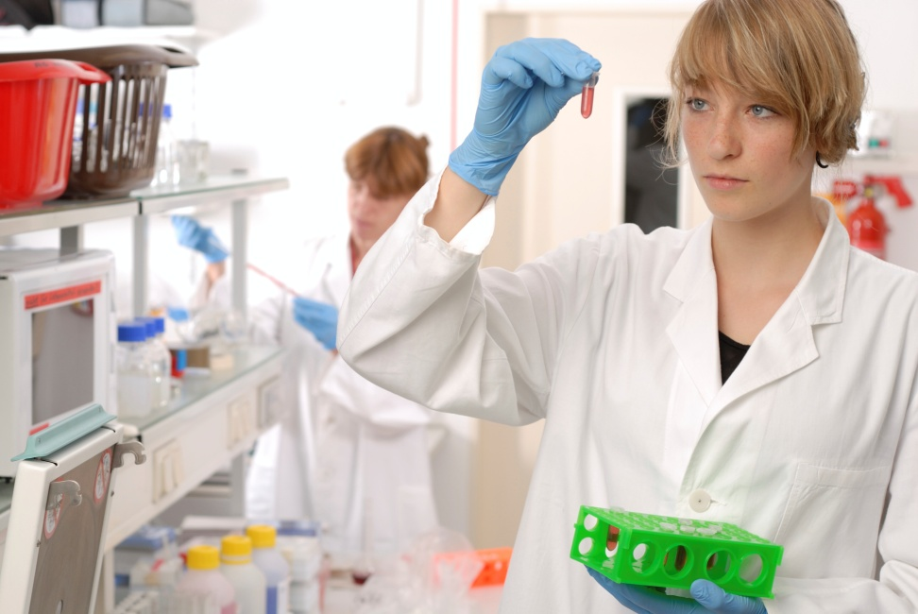
In One Health,
We study how animals, and people can live together in a healthy world.
Notes:
Those cows are a food source for many. A healthy cow makes for healthy food if processed in a healthy way.

Slide 3
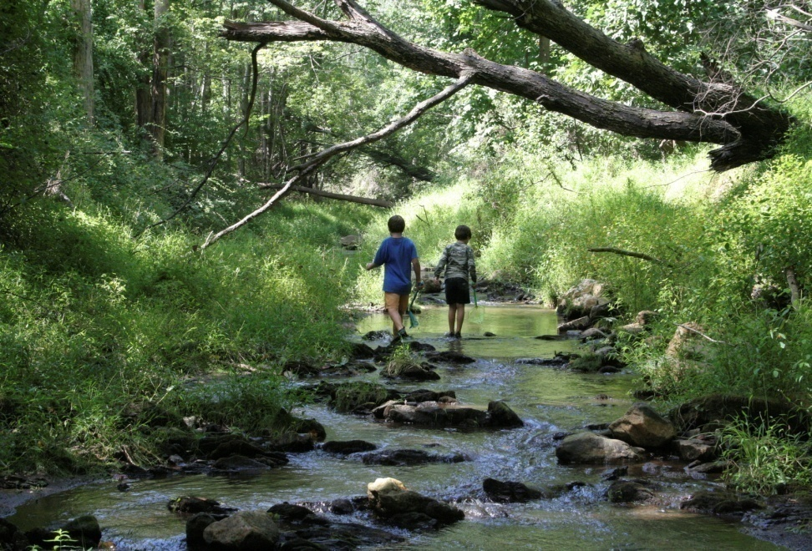
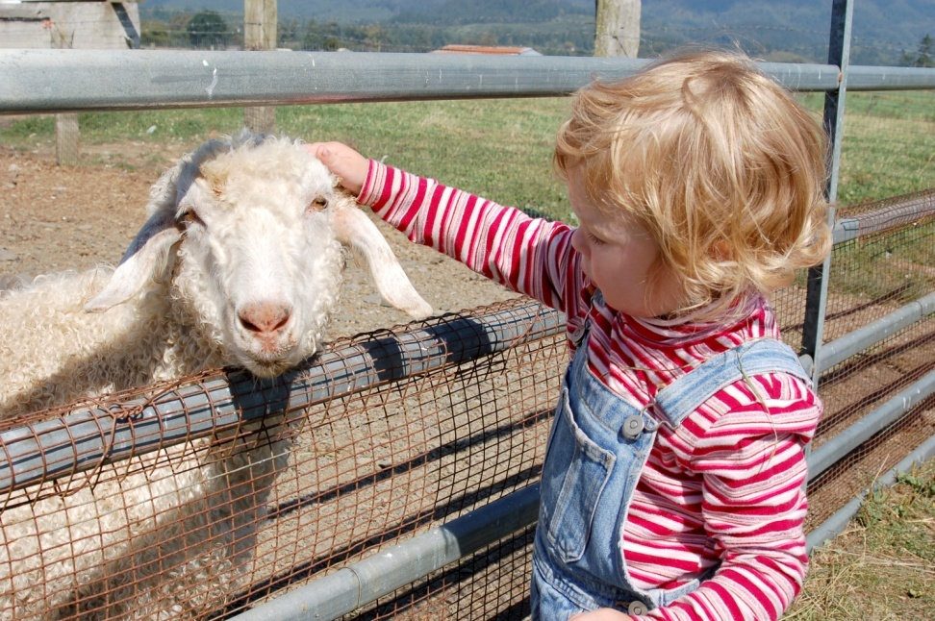
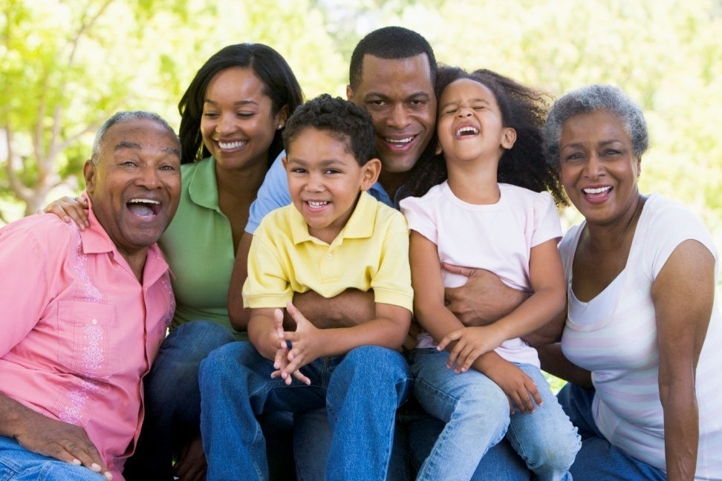
Living together in our environment without getting sick is sometimes hard to do.
Notes:
We play outside where air and water move around a lot. Some animals are nice to pet and love. What kind of pets do you have? (discussion time) Do you go all the places your pet goes and touch all of the things your pet touches? (No, they touch some pretty yucky stuff. When we touch our pets, we touch some of the things they touched, too. It is fun to get together in the company of other people. When we do these things, we share more than good times. Sometimes we share germs and chemicals which are not healthy for us. Germs can pass from person to person, or from a sick person to an object that can be touched by others, and then that person gets sick.

Slide 4
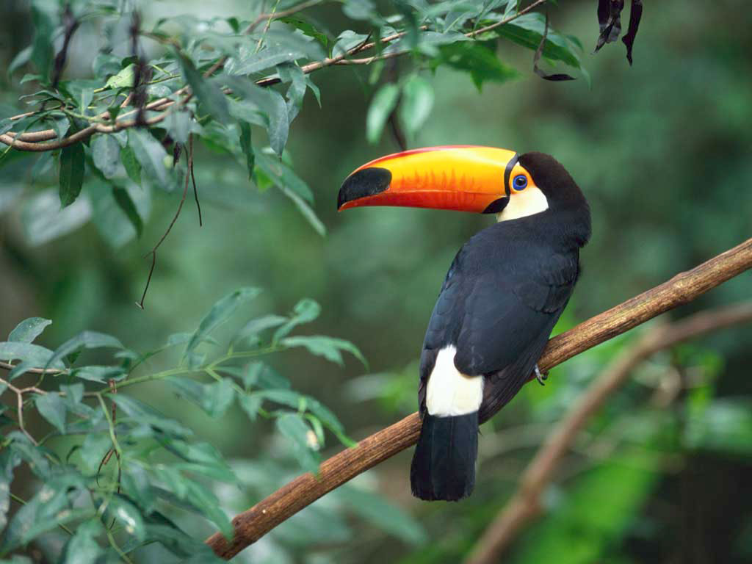


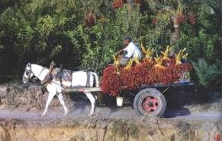
Global Trade & Travel
Our food comes from the grocery store,
but where did they get it?
Notes:
One of the areas we study at ONE HEALTH is our food sources. Our grapes might come from California. Our oranges may come from Florida. Wheat for our bread might be raised in Kansas, but it might go to another state to be processed and baked. When our food and drink does not come from Kansas, it is shipped from other parts of the U.S. , and the world. For example, in winter, our grapes or oranges may come from South or Central America. How do you think your parents would feel about a day that starts without their morning coffee? Coffee is usually shipped year round from outside the U.S.
Photo credits: Windows sample pictures, Joni Teeter, USEPA Region 8
Exotic pets, global trade, travel; diseases transmitted over a wider area with greater speed

Slide 5

The air, water, and land around us affects our health
Air Quality
Water Quality
Solid waste issues
Food safety
Notes:
The air we breathe travels from one place to another. We are breathing in the air in this room all together. We breathe it out too. Everyone here looks very healthy, but what if someone gets sick and still comes to school? When they cough or sneeze, they put germs in the air that someone else will breathe. (That’s why it’s important to “sneeze into your sleeve”. If you sneezed or coughed into your hand, and then went for a drink at the water fountain, the germs would go from your hand to the water fountain handle (and everywhere else your hand went before getting washed.)
Would you ever drink from someone else’s glass? If you do, their germs are in the glass, and if you drink from it, their germs can go into you as you swallow that drink. The water we drink, and the water we play in, are tested to keep us safe. The water we have is part of the water cycle. When it rains, water is collected in lakes and rivers, and treated for us so it can come to your house for your use. It’s important for our city to test your water often to be sure you won’t get sick.
Solid Waste-If someone blows their nose, their germs are in that tissue. If that tissue blows out of the trash and onto a surface you touch, you could get sick too. After our trash is picked up at our house, it is important that wastes be taken to a safe place where people do not live. A landfill, or incinerator help keep us safe. The solid waste dept. makes sure that solid wastes will stay away from us. Insects and animals can get into the trash and spread it from the landfill or dumpster and get back to us.
Food safety- food is free of contaminants, and disease(That’s why our Govt. inspects foods, and establishes food safety standards.)

Slide 6
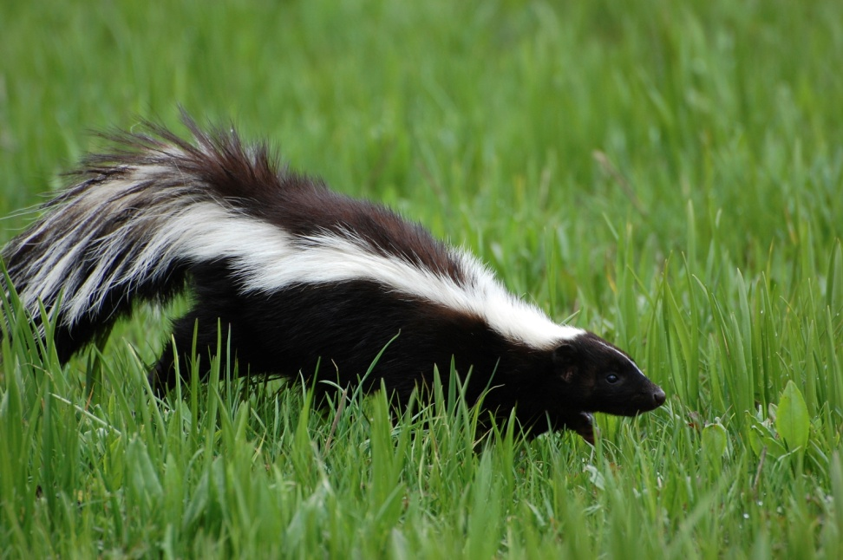
Zoonotic diseases
Rabies
West Nile Virus
Rocky Mountain Spotted Fever
Salmonella
Giardia
Notes:
Let’s look at that big word “Zoonotic” Look at just the first three letters. Where have you seen them before, and what do they mean? A zoo has animals. ZOONOTIC DISEASE means animals transmit the disease. Have you ever wondered why flies landing on your sandwich at the picnic is not a good idea? Flies could land on all kinds of dirty places, pick up those germs, and then put germs on your sandwich. A mosquito can give you an itchy bite, but what if it bit someone who was sick and then later bit you. You could then get sick. Some diseases make us sick quickly, like having to go to the bathroom every 15 minutes. You could have an upset stomach within hours of eating food that has germs. Other diseases can make us run a fever, or cause nerve or brain damage. Some diseases, like Rabies, cause death. One Health tries to help us understand how to be outdoors without having animals give us disease. How do we do that?
Never try to pick up or pet a wild animal.
Apply bug spray when you are outdoors.
Bring your own water bottle to a picnic or hike, and don’t drink from lakes or rivers, no matter how clear and clean the water looks.

Slide 7
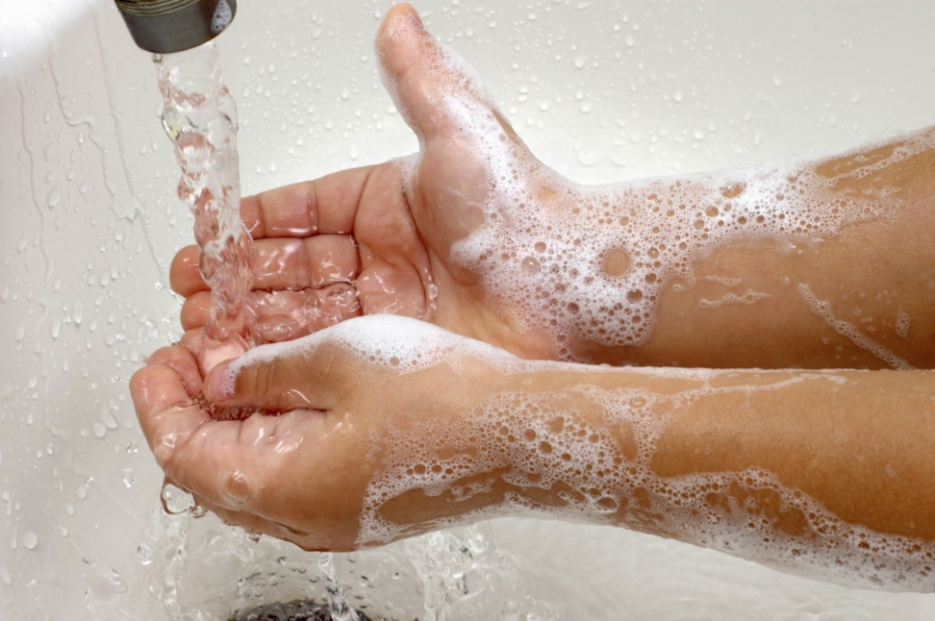
#1 way to keep from getting sick from Zoonotic Disease is to …
Wash Your Hands!
Before eating or cooking
After going to the bathroom
After petting animals
Notes:
Most hand sanitizers are good when you cannot wash hands with soap and water, but it will not prevent the spread of Norovirus, a type of flu.

Slide 8
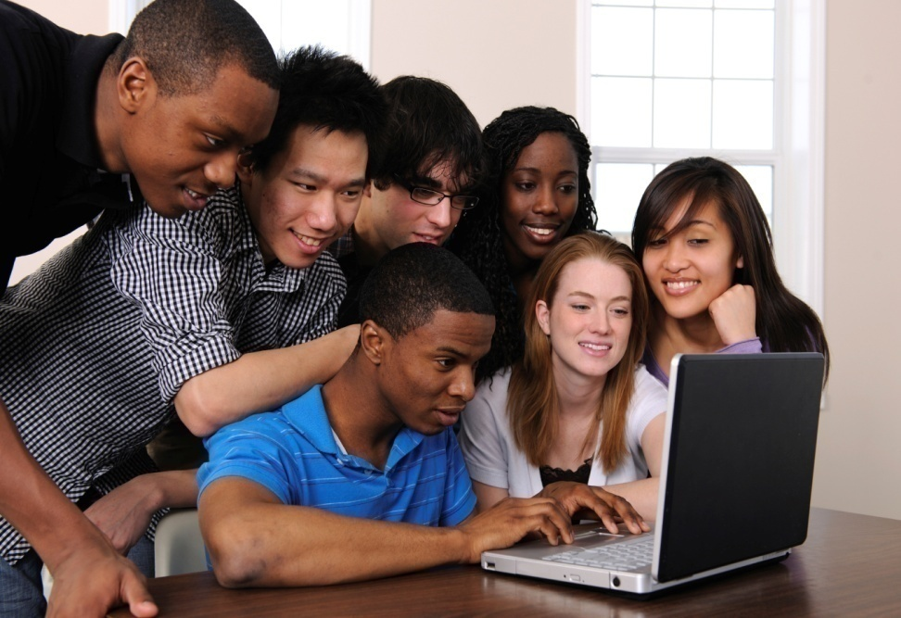
One Health
Connecting people, animals and their environment through research-informed education
Creating a pipeline of health professionals to meet the need
  K-12 Education and Outreach
  Pathways to Public Health
  Workforce Development
  Infection Prevention
Martha Nowak, M.Ed.
K-12 Engagement Coordinator/K-State Olathe
22201 W. Innovation Drive
Olathe, KS 66061
913/307-7321
msnowak@ksu.edu
Notes:
Now do the Zoonosis and your Pet activity:
Spread Glo-Germ lotion on the new tug rope, particularly on the knots where children will play “tug” with their dog.
Have students number off 1,2,1,2,1,2,etc. Once in twos, have students take turns tugging with their partner, and pass it on to the next partners until all have played “tug”.
Have students look under the U-V light to see “germs”.
Have them wash their hands and check to see how well they washed them.
Suggest trying again, but this time count to “30” by saying one one-thousand, two one-thousand, three one-thousand, etc. Rinsing only after they’ve completed the counting, and dry hands thoroughly on a paper towel.

