Slide 1
What is
One Health?

Slide 2
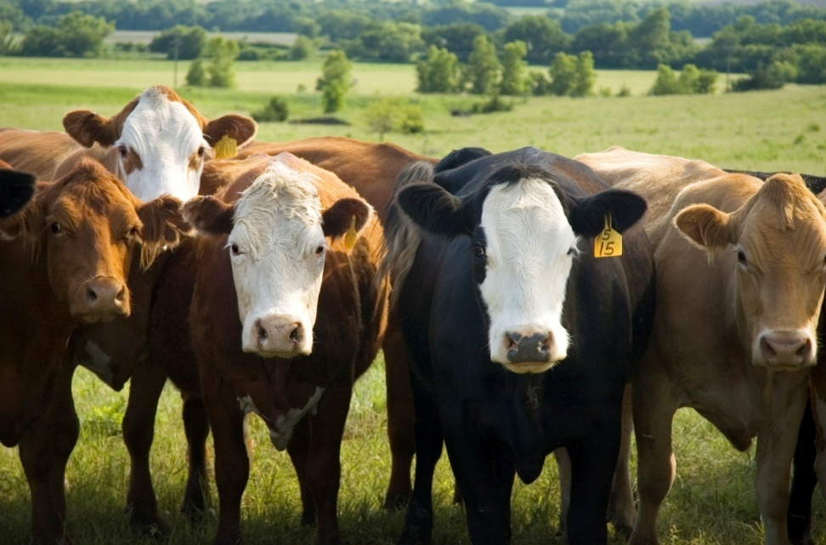
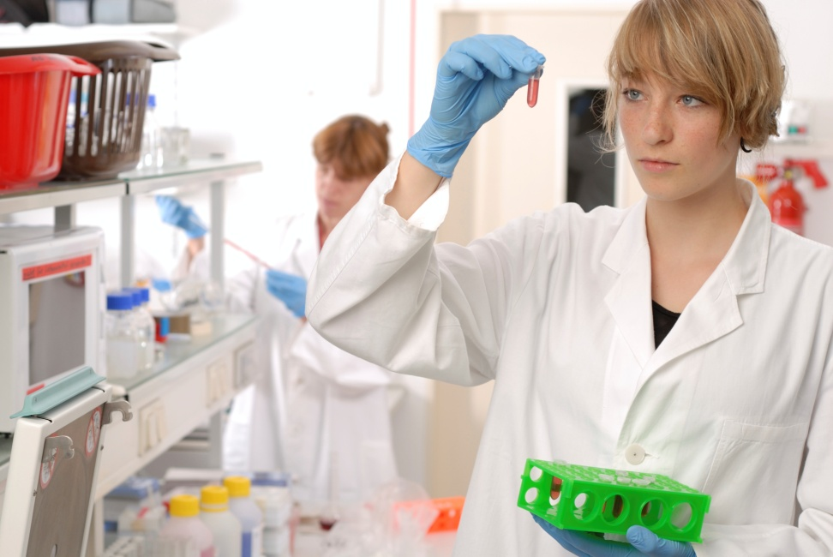
In One Health,
We study how animals, and people can live together in a healthy world.
Notes:
Those cows are a food source for many. A healthy cow makes for healthy food if processed in a healthy way.

Slide 3
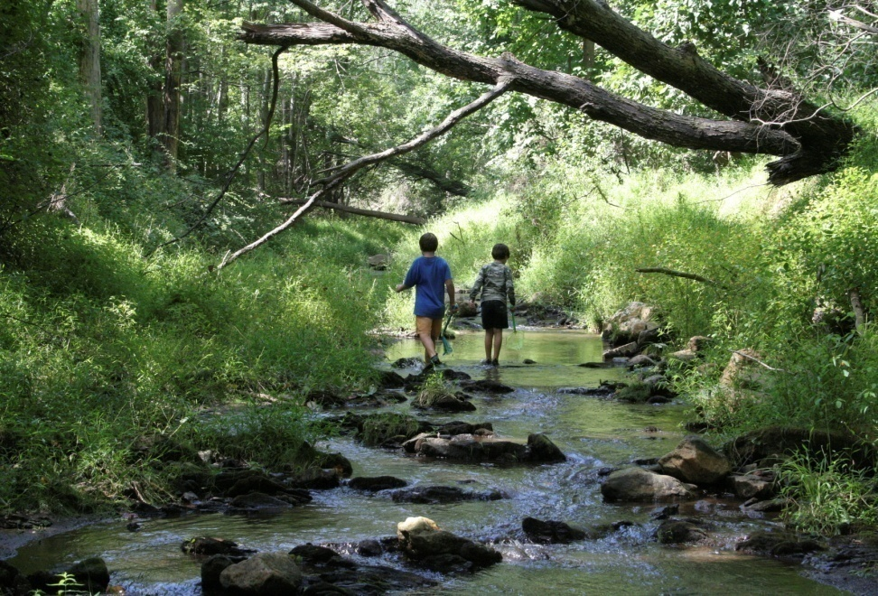
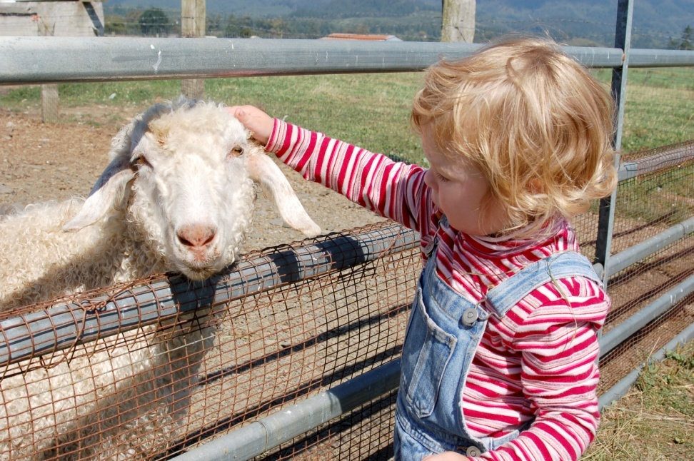

Living together in our environment in a healthy way is sometimes a challenge.
Notes:
The environment has freely moving air and water. What is in one water source becomes part of all water sources because of the water cycle. Water picks up dissolved particles in the soil and carries it from one place to another, particularly during storm events sometimes contaminating our source of drinking water. (overloads the wastewater and water treatment filtering systems in place in communities) When we interact with animals and other people, we share not only good times. We share germs or chemicals that sometimes make us sick.

Slide 4
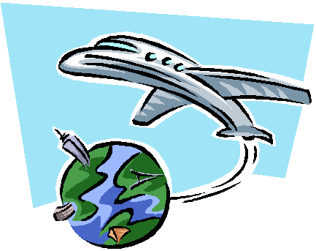
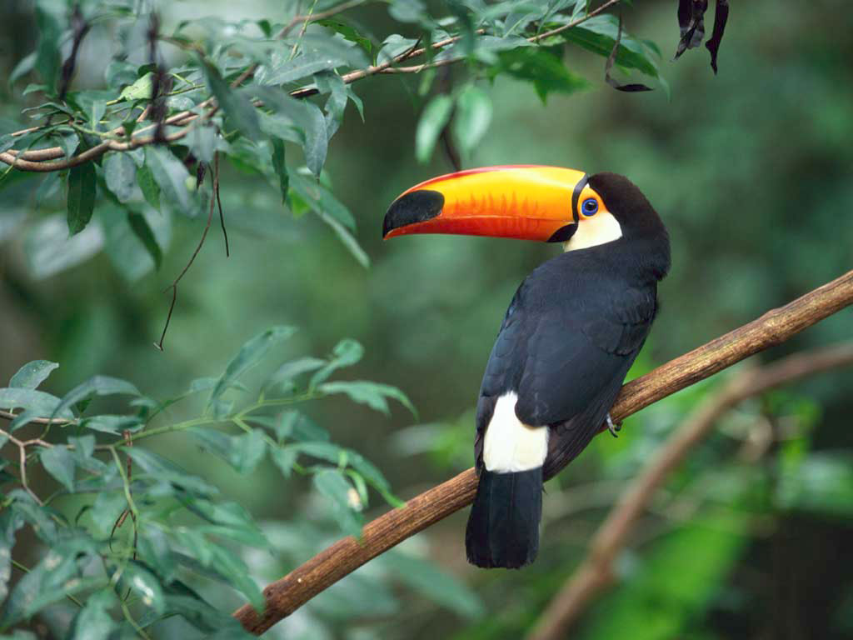
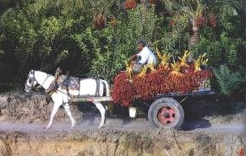

Global Trade & Travel
Food, people and diseases travel
quickly around the world.
Notes:
At One Health, we look at global trade and travel. Not all our food is local. When our food and drink is not raised locally, it is shipped from other parts of the U.S. , and the world. Where do our grapes or apples come from in winter? What foods do not come from the U.S. that you like to eat? (Coffee is usually shipped year round from a country outside the U.S.)
Photo credits: Windows sample pictures, Joni Teeter, USEPA Region 8
Exotic pets, global trade, travel; diseases transmitted over a wider area with greater speed

Slide 5
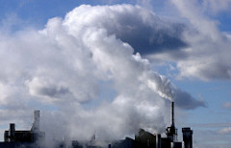
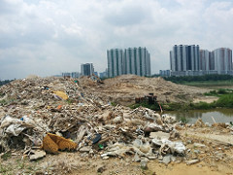


Environmental health impacts human health
http://www.unmultimedia.org/photo/
Air Quality
Water Quality
Solid waste issues
Food safety
https://creativecommons.org/licenses/by/2.0/
https://www.flickr.com/photos/usepagov/
Notes:
Air Quality-Car and industry emission standards established by the govt. must be monitored. We have to be made aware of indoor pollutants which affect our health. Old buildings go through renovations to remove asbestos, and defective ventilation systems.
Water quality- the water we drink, and the water we play in, are tested to keep us safe, and agencies warn us of risks, should any arise.
Solid waste-After our trash is picked up at our house, it is important that wastes not leak into water sources. The city, and state agencies help keep us safe.
Food safety- Our Govt. inspects foods, and establishes food safety standards. One Health Kansas educates the public about health risks.

Slide 6
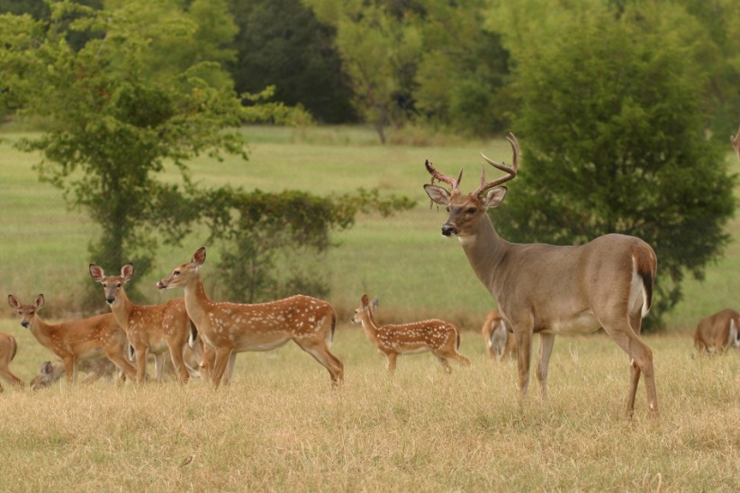
At One Health we look at:
Human-animal bond
Disaster response
Zoonotic disease
Foodborne illness
Animal bites and prevention
Environmental impacts

Slide 7
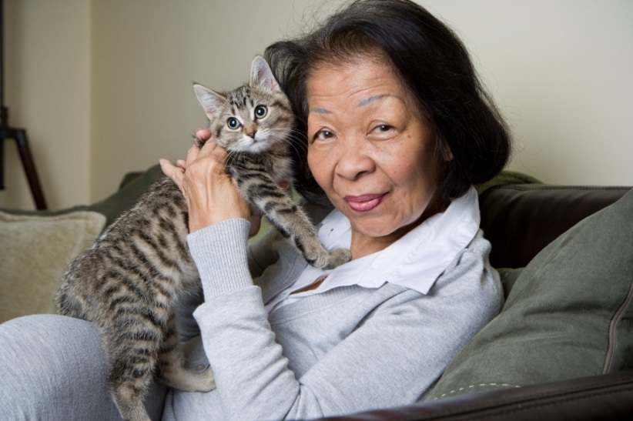
Animal-Human Bond
Improved emotional health
Increased physical activity
Fewer doctor visits
Lessons learned:
  Hurricane Katrina
  Greensburg
  Kansas State Animal Response Team www.kssart.org
  National Animal Disease Response http://bit.ly/1OZKWsH
Notes:
Pets make our lives richer, better.
When we are separated from our pets by natural disaster(like flood, tornado, hurricane) KSSART helps us locate and reunite us with our pets.

Slide 8
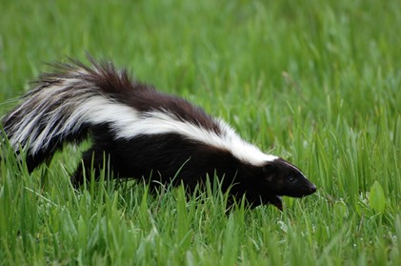

Zoonotic diseases
Some diseases are transmitted between animals and humans:
Rabies
West Nile Virus
Rocky Mountain Spotted Fever
Salmonella
Giardia
Notes:
Let’s look at that big word “Zoonotic” Look at just the first three letters. Where have you seen them before, and what do they mean? A zoo has animals. ZOONOTIC DISEASE means animals transmit the disease. Have you ever wondered why flies landing on your sandwich at the picnic is not a good idea? Flies could land on all kinds of dirty places, pick up those germs, and then put germs on your sandwich. A mosquito can give you an itchy bite, but what if it bit someone who was sick and then later bit you. You could then get sick. Some diseases make us sick quickly, like having to go to the bathroom every 15 minutes. You could have an upset stomach within hours of eating food that has germs. Other diseases can make us run a fever, or cause nerve or brain damage. Some diseases, like Rabies, cause death. One Health tries to help us understand how to be outdoors without having animals give us disease. How do we do that?
1. Never try to pick up or pet a wild animal.
2. Apply bug spray when you are outdoors.
3. Bring your own water bottle to a picnic or hike, and don’t drink from lakes or rivers, no matter how clear and clean the water looks.
Some diseases give us symptoms quickly, like having to go to the bathroom every 15 minutes. You could have an upset stomach within an hour of eating contaminated food. Other diseases can make us run a fever, or cause nerve or brain damage. One Health tries to help us understand how to be outdoors without having animals give us disease.

Slide 9
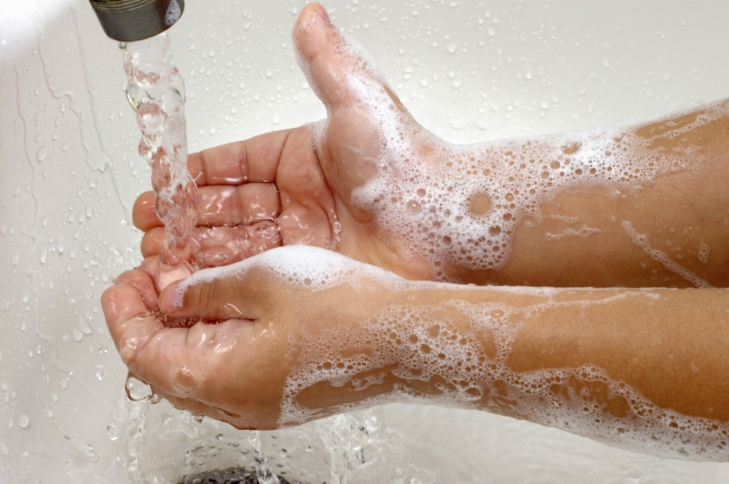
#1 way to keep from getting sick from Zoonotic Disease is to …
Wash Your Hands!
Before eating or cooking
After going to the bathroom
After petting animals
Notes:
Most hand sanitizers are good when you cannot wash hands with soap and water, but it will not prevent the spread of Norovirus, a type of flu.

Slide 10
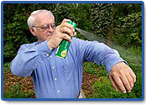
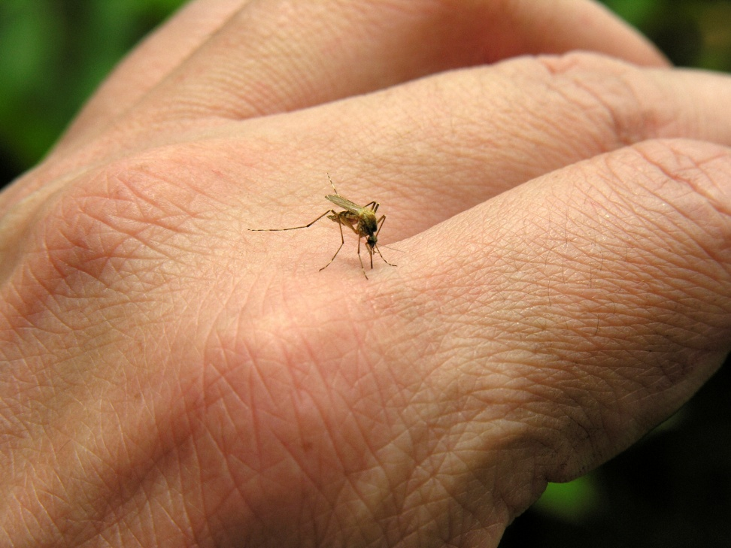
Zoonotic Disease Prevention:
Vector Control
Vectorborne illness
West Nile Virus (mosquito)
Rocky Mountain Spotted Fever (tick)
Lyme Disease (tick)
Control measures
Interrupt insect life cycle
ID insect habitats
Remove standing water to prevent mosquito breeding grounds
Apply insecticide to breeding areas (or self, when going outside).
Notes:
When I take my horse to horse shows, I am required to have a Health certificate and up-to-date vaccinations through which any state I travel.

Slide 11
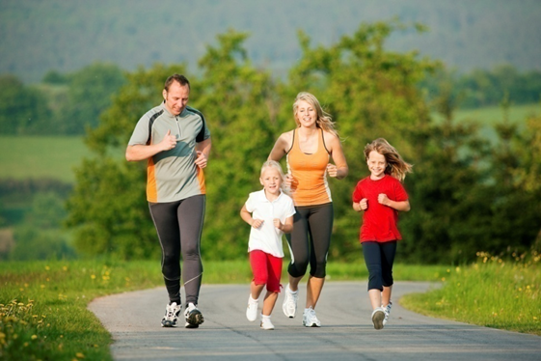
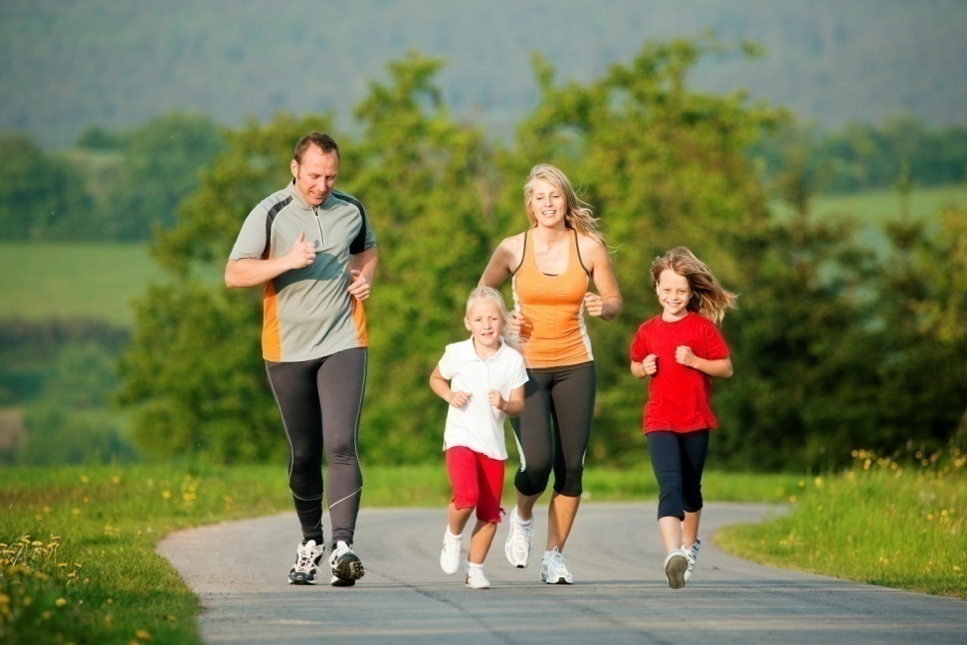
Cities, states, and the nation work together for
Better Public Health and Urban Planning
Walkable Communities
Built environment
Community gardens
Physical activity
Nutrition
Notes:
Walkable communities-encourage us to walk and bike rather than use cars.
Built environment-The physical layout of our cities with buildings can encourage us to have a healthy lifestyle.
Community gardens-help us help us look at food personally, and decide whether we want to add bug sprays or other chemicals to our foods.
Physical activity-One Health encourages people to get plenty of exercise to increase your heart rate and stay healthy.
Nutrition-Read the labels and choose what foods and drink are best for you.

Slide 12

Video on Zoonosis and your pet

Slide 13

One Health
Connecting people, animals and their environment through research-informed education
Creating a pipeline of health professionals to meet the need
  K-12 Education and Outreach
  Pathways to Public Health
  Workforce Development
  Infection Prevention
Martha Nowak, M.Ed.
K-12 Engagement Coordinator/K-State Olathe
22201 W. Innovation Drive
Olathe, KS 66061
913/307-7321
msnowak@ksu.edu

