Slide 1
Exploring Public Health Careers
Martha Nowak, M.Ed.
Program Coordinator for One Health Kansas
August 28, 2014

Slide 2
Outline
What is your definition of Public Health? Write it down.
Public Health Definition
What are the areas of Public Health?
Food Safety and Biosecurity
Public Health Nutrition
Infectious Disease and Zoonoses
Public Health Physical Activity

Slide 3
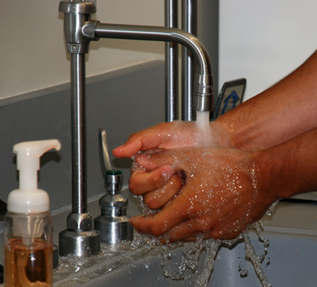



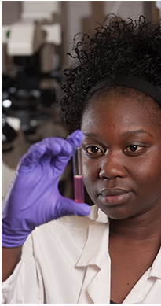

Public Health

Slide 4
Public Health Definition
20th Century Definitions
Public Health is “… the science and art of preventing disease, prolonging life and promoting health … through organized community efforts...” – Winslow
The substance of public health is the “organized community efforts aimed at the prevention of disease and the promotion of health.” – Institute of Medicine
Notes:
Health means a state of complete physical, mental and social well-being and not merely the absence of disease or infirmity. – World Health Organization

Slide 5
Public Health definition cont.
21st Century Definition
The totality of all evidence-based public and private efforts that preserve and promote health and prevent disease, disability and death
How does this definition compare to the one you wrote down?

Slide 6
What is Public Health?
Everything! (Part of Our Daily Lives)
Prevention!!!
Population Health Approach
  Healthy People-Healthy Populations
  Evidence-based approach
  Analyzes determinants of health and disease
  Determines interventions to preserve and improve health
What do you think of when you hear “Public Health”
  Not sure 10%
  Protecting the public from deceased 16%
  Policies and programs that maintain healthy living conditions 27%
  Gov’t provided Health Care System for all and Health Care for the 47%

Slide 7
Why Public Health?
Public health addresses the health needs of populations as a whole instead of individuals
Public health professionals fight to improve the health of the population on a daily basis, for the elimination of health disparities, and for health care as a right for everyone
The focus of public health is prevention rather than treatment of diseases

Slide 8
Public Health Links
Healthy People 2020 Video
  General Health Status
  Health-Related Quality of Life and Well-Being
  Determinants of Health
  Disparities
ASPH, APHA,KPHA, CDC
What is Public Health?
Healthiest Nation in 1 Generation

Slide 9
Careers in Public Health
Epidemiology and biostatistics involve mathematics and modeling
Environmental health includes a wide range of science skills
Health administration incorporates business and management skills
Health education involves skills required to develop community-wide prevention programs
Health policy includes an understanding of law-making processes

Slide 10
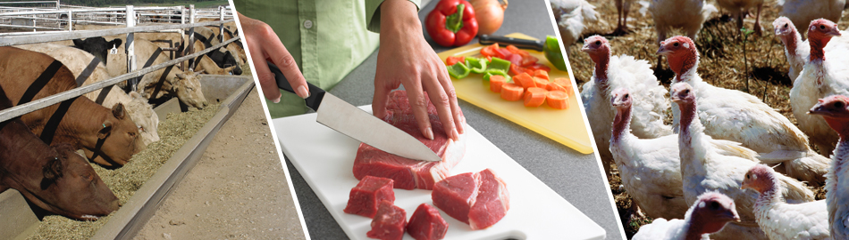
Food Safety and Biosecurity

Slide 11
Food Safety Definition:
The conditions and practices that preserve the quality of food to prevent contamination and foodborne illnesses

Slide 12
Food Safety Function
Properly handling and preparing food greatly reduces the risks of getting foodborne illnesses
Food can be contaminated in several different ways:
  Improper handling during processing
  Improper temp. during storage & transport
  Failure to cook or store the food properly can cause further contamination

Slide 13
Why Food Safety and Biosecurity?
CDC estimates that each year roughly 1 in 6 Americans (or 48 million people) gets sick, 128,000 are hospitalized, and 3,000 die of foodborne diseases
USDA seeks to reduce the incidence of foodborne illness and provide a safer food supply by supporting research, education, and extension activities

Slide 14
Food Poisoning
Occurs when you swallow food or water that has been contaminated with certain types of bacteria, parasites, viruses, or toxins
Often due to common bacteria such as Staphylococcus or Escherichia coli (E. coli)
More common after eating at picnics, school cafeterias, large social functions, or restaurants where one or more people may become sick

Slide 15
USDA Food Safety and Biosecurity
Farm-to-fork food safety
  Pre-harvest Food safety
    Reduce number and risk of pathogens
    Develop intervention strategies
    Out of your control
  Post-harvest food safety
    Safe food culture
    Food preparation techniques
    Within your control

Slide 16
Food Safety Links
USDA National Institutes of Food and Agriculture
International Food Safety Network
CDC: Food Safety
Food Safety.gov
  Four steps to food safety
    Clean
    Separate
    Cook
    Chill

Slide 17
Biosecurity and On-Farm Food Safety
Biosecurity is a preventative approach to herd health, to minimize risk of disease frequency
A series of management practices designed to minimize or prevent the importation of infectious agents onto a farm
Management practices include:
  microbial surveillance, isolation or quarantine of infected animals, immunization, selective purchasing, and monitoring herd evaluation

Slide 18
Careers in Food Safety
Director of Food Safety/ Compliance
Food Inspector
Food Safety Sanitation Technical Specialist
Laboratory Analyst
Supervisory/Veterinary Medical Officer
Food Safety Manager
Food Technologist

Slide 19

Public Health Nutrition

Slide 20
Public Health Nutrition
Emphasizes the application of food and nutrition knowledge, policy, and research to the improvement of the health of populations
Prepares professionals to apply evidence-based nutrition intervention principles to promote healthful eating in populations, focusing on relationship between nutrition and health
PHN topics: nutritional epidemiology; obesity prevention; and intervention strategies for impacting health through nutrition
http://sph.berkeley.edu/areas-study/public-health-nutrition

Slide 21
Public Health Nutrition
Promotes good health through nutrition and the reduction of nutrition-related illness
Seeks to target the causes of, approaches, and solutions to nutrition-related public health problems around the world

Slide 22
Why Public Health Nutrition?
Chronic diseases account for 70% of all deaths in the US, such as heart disease, cancer & diabetes
Causes major limitations in daily living for almost 1 out of 10 Americans (25 million people)
Leading causes of death and disability in the United States are nutritionally, or environmentally preventable through healthier lifestyle choices

Slide 23

Good Public Health Nutrition Resources
The Nutrition Society
Center for Disease Control & Prevention
American Soc. For Nutrition
Nutrition.gov
Family Nutrition Program
Extension Human Nutrition

Slide 24
Careers in Public Health Nutrition
Supervisory Public Health Nutritionist
Family Health Nutritionist
Extension Agent in Nutrition
Registered Dietitian
Assistant Public Health Nursing Chief
Clinical Nutritionist
Nutrition Program Director
Notes:
http://www.whatispublichealth.org/careers/pfizerguide/nutritionist.pdf
http://www.utexas.edu/lbj/sites/default/files/file/careers/APSIA%20-%20PUBLIC%20HEALTH%20&%20NUTRITION.pdf

Slide 25

Infectious Disease and Zoonoses

Slide 26
Infectious Disease and Zoonoses
Human communicable diseases can be classified according to the source of infection
Anthroponoses: when the source is an infectious human; interhuman transfer is typical
Zoonoses: the source is an infectious animal; interhuman transfer is uncommon

Slide 27
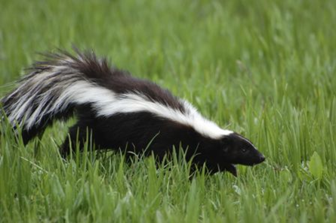
Zoonotic Diseases
Zoonotic diseases are diseases that can be transmitted from animals to humans
Examples: Rabies, Brucellosis, Q fever, Hantavirus pulmonary syndrome, Leptospirosis, Psittacosis, Trichinosis,
Routes of transmission
  Fecal-oral
  Bites/scratches
  Vectors
    Mosquitoes, ticks, fleas
  Foodborne
  Contaminated water supplies

Slide 28
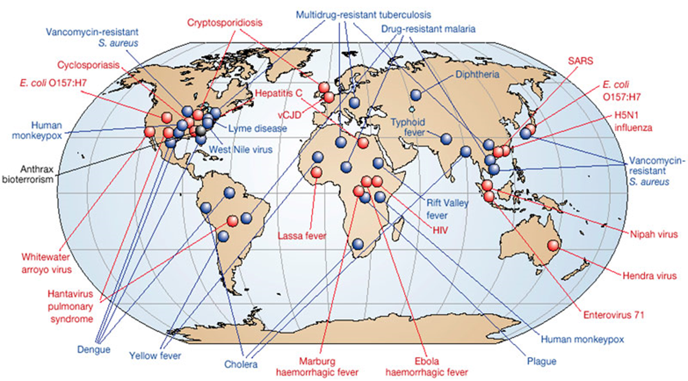
Emerging Diseases
60% of diseases currently recognized in humans are due to pathogens that affect multiple species
Approximately, 75% of emerging human infectious diseases are diseases of animal origin
Source: NATURE; Vol 430; July 2004 www.nature.com/nature
Notes:
https://www.onehealthcommission.org/en/fast_facts/
The recent increase of emerging and reemerging zoonotic diseases that affect both humans and animals has caused an increase in the need for communication and education about the One Health concept at all levels of academia.

Slide 29
Infectious Disease and Zoonoses Links
CDC Infectious Disease and Zoonoses
AMA: American Medical Association
ASTMH: American Society of Tropical Medicine and Hygiene
AVMA: American Veterinary Medical Association
CEEZAD: Center of Excellence for Emerging and Zoonotic Diseases

Slide 30

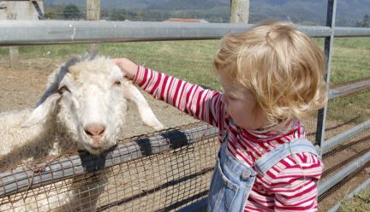
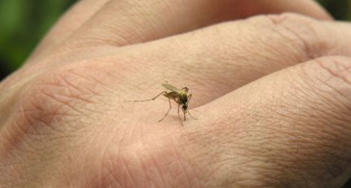

One Health
“One Health is the collaborative effort of multiple disciplines – working locally, nationally, and globally – to attain optimal health for people, animals and our environment.” – American Veterinary Medical Association

Slide 31
Why One Health?
As animal habitats are destroyed to accommodate increasing populations, humans are exposed to new disease threats from animals
Globalization results in diseases quickly spreading around the world
The way we build our neighborhoods and cities influence the amount of exercise we get

Slide 32
Dog Bites
4.5 million per year
885,000 require medical attention
31,000 required reconstructive surgery in 2006
Who is at risk?
  Children, especially ages 5-9 years
  Adult males
  People with dogs in their homes

Slide 33
Dog Bites cont.
Prevention
  Before bringing a dog into your home:
    Consult with a professional
    Be aware of dog’s history
    Be sensitive to children’s fear
    Spend time with dog prior to purchasing or adoption

Slide 34
Dog Bites cont.
Prevention
  If you decide to bring a dog into your home:
    Spay/neuter
    Never leave children alone with dog
    Do not play aggressively with dog
    Properly train and socialize dog
    Seek professional help if dog has aggressive behavior

Slide 35






Organizations that Promote One Health
Notes:
The aim of the One Health Commission is to improve the health of people, animals, and our environment by uniting public health professionals and promoting professional collaborations.5 The One Health Initiative has used the internet to educate people about the connection between human health, animal health, and ecosystem health, while promoting the group work effort of health care professionals for the improved health of all.6

Slide 36
One Health Links
CDC
CDC’s National Center for Emerging and Zoonotic Infectious Diseases
One Health Commission
One Health Initiative
One World, One Health
UC Davis’ One Health Institute
University of Saskatchewan One Health Guide
USDA APHIS Veterinary Services’ One Health Office
World Rabies Day

Slide 37
Careers in Infectious Disease/Zoonoses
Veterinarian
Veterinary Assistant
Veterinary Tech/Assistant
Senior Laboratory Technologist
Director of Health and HIV/AIDS
Epidemiologist
TB/HIV Technical Advisor to Ministry of Health (MOH)

Slide 38

Public Health Physical Activity
  Urban Planning for Walkable Communities
  Encourage the public to be active

Slide 39
Physical Activity
Is defined as any bodily movement produced by skeletal muscles that requires energy expenditure
Walking, gardening, briskly pushing a baby stroller, climbing the stairs, playing soccer, or dancing the night away
For health benefits, physical activity should be moderate or vigorous intensity

Slide 40
Why Public Health Physical Activity?
Physical inactivity has been identified as the fourth leading risk factor for global mortality causing an estimated 3.2 million deaths globally
Regular moderate intensity physical activity –– has significant benefits for health
Such as: reduction of the risk of cardiovascular diseases, diabetes, colon and breast cancer, and depression, decrease the risk of a hip or vertebral fracture and help control weight

Slide 41
Public Health Physical Activity Links
CDC Physical Activity
National Physical Activity Society
Physical Activity Resource Center for Public Health (PARC-PH)
K-State MPH Public Health Physical Activity
World Health Organization Physical Activity

Slide 42
Careers in Public Health Physical Activity
Physical Education Teacher
CrossFit Trainer
Rehabilitation Specialist
Physical Activity Director
Athletic Director

Slide 43

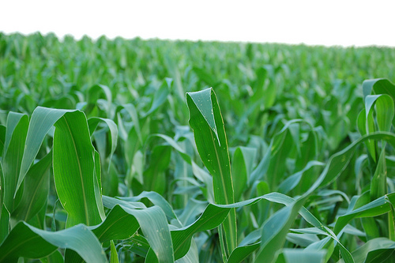

Environmental Health
Solid waste management
Air quality
Soil quality
Water quality

Slide 44
Environmental Health links
Association of Environmental Health Academic Programs
National Environmental Health Association
EPA
CCDEH
Environmental Health Safety Jobs
CDC NCEH

Slide 45

Questions

Slide 46
Conclusion/Discussion
What did you learn?
How can you apply what you learned
What career related to Public Health interest you?
What major at K-State will help you achieve your career goals?
Activity on cell phones…go to: http://www.educationplanner.org/students/career-planning/find-careers/career-clusters.shtml

Slide 47
References, Websites and Resources
Redmond EC, Griffith CJ. Consumer food handling in the home: a review of food safety studies. J Food Prot. 2003;66(1):130-161.
Riegelman, R. (2010). Public Health 101: Healthy People- Healthy Populations. Sudbury, Massachusetts: Jones and Bartlett Publishers
Food safety http://www.umm.edu/ency/article/002434.htm#ixzz2U7t1B8qe University of Maryland Medical Center
Wilson CEA. The untitled field of public health. Mod. Med. 1920: 920;2:183-191.
Institute of Medicine. The Future of Public Health. Washington, DC National Academy Press:1988:41
Hubalek Z. Emerging human infectious diseases: Anthroponoses, zoonoses, and sapronoses. Emerg. Infect. Dis. 2003;9:403–404.
http://www.nutritionsociety.org/publications/nutrition-society-journals/public-health-nutrition
http://www.k-state.edu/mphealth/areas/human_nutrition.html
http://www.umm.edu/ency/article/002434.htm#ixzz2U7rTcEzQ
http://academy.asm.org/images/stories/documents/preharvestfoodsafetycolor.pdf
http://www.ncbi.nlm.nih.gov/pubmed/1925034
http://www.cdc.gov/Features/AnimalExhibits/index.html

