Slide 1
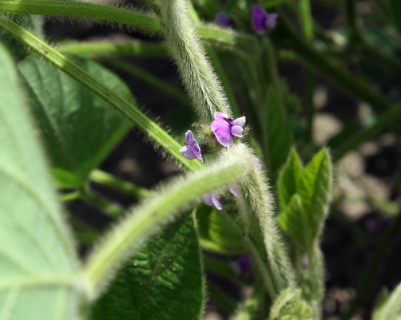
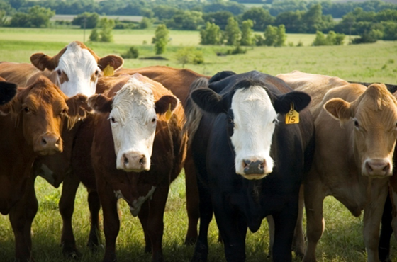
Zoonotic Disease and Agriculture
Martha Nowak, M.Ed.
K-12 Engagement Coordinator
Kansas State University-Olathe

Slide 2
Zoonotic Disease Fast Facts…
Zoonotic disease is any disease that can be transmitted between animals and humans.
Examples include Rabies, Salmonella, Giardia, E. coli, and tick-borne diseases.

Slide 3
3. Zoonotic diseases pose
a special problem for
agriculture because clinical
diagnosis can be difficult.
People, as well as animals,
can be asymptomatic.

Slide 4
Estimate the rankings(1-4) by number of illnesses and deaths from 1998-2008
Illnesses Deaths
Produce
Meat and poultry
Dairy and eggs
Fish and Shellfish

Slide 5
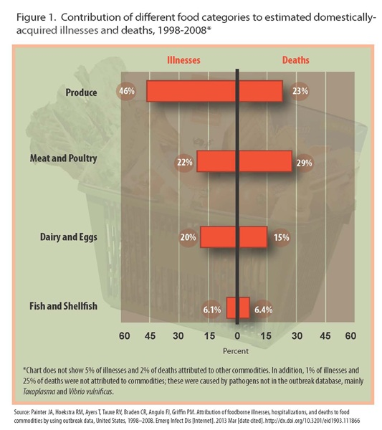

Slide 6
Common Bacterial Pathogens
Leptospira
Mycobacterium bovis
Campylobacter
E. coli
Salmonella
Q-Fever (Query Fever)

Slide 7
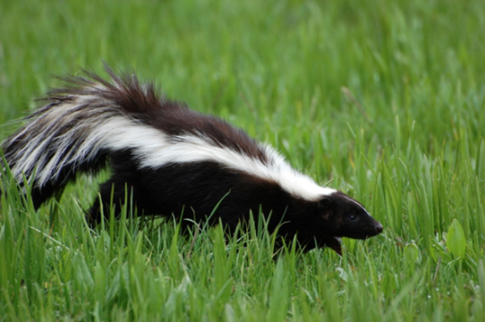
Leptospira
Carried in infected wild animal urine
Can travel to water source through surface runoff, or it may soak into the groundwater(esp. a concern in rural well water)
Food crops can be contaminated with infected urine.

Slide 8
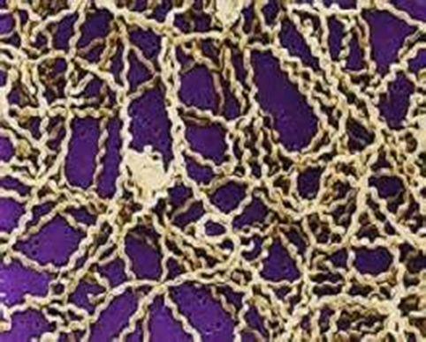
Leptospirosis in Humans:
  Flu-like symptoms: High fever,
  headache, chills, vomiting
  diarrhea
  Jaundice (yellow eyes and
  skin), red eyes, Some people
  do not have symptoms. This disease can
  cause kidney or liver failure or meningitis.
  Control Measures:
  wash all fruits and vegetables before eating them.
  drink only from tested and trusted sources.

Slide 9

Mycobacterium bovis
Human cases usually sourced to unpasteurized dairy products
So what do we do?
  Isolate and screen herd replacements
  Contact veterinarian so that they can identify probable routes of transmission
  Identify and treat secondary contacts(companion animals)

Slide 10

Campylobacter
Sources: Unpasteurized dairy products, contaminated water, produce, and undercooked poultry.
Exposure: One drop of raw chicken juice is enough to infect a person
Symptoms: diarrhea, & bloody diarrhea
After you touch a chick, duckling, or other baby bird, or anything in the area where they live and roam, WASH YOUR HANDS, to reduce illness.

Slide 11
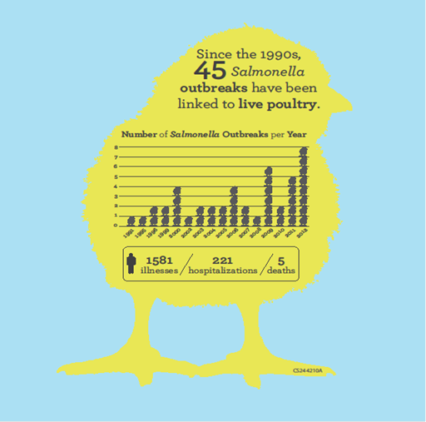
Salmonella
Salmonella gastrointestinal infections usually resolve in 5-7 days and most do not require treatment other than oral fluids. Persons with severe diarrhea may require hospitalization and rehydration.
in severe cases: prolonged diarrhea, high fever, bloodstream infection

Slide 12
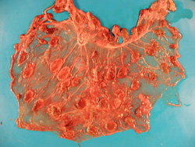
Q Fever
Coxiella burnetii
Q fever is a highly contagious, viral zoonotic disease that is usually asymptomatic but can cause abortions or stillbirths in ruminants.
Description:
Goat, placenta. Most cotyledons have pale tan margins (necrosis). There are scattered raised tan discrete intercotyledonary plaques (exudate) and a locally extensive area where the intercotyledonary placenta is opaque, thickened and tan.
Credit: Dr. J. Arzt, PIADC
Photo ID: QF_001

Slide 13
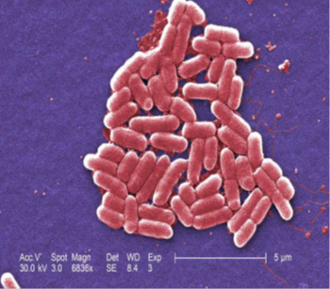
Escherichia coli
(E. coli), specifically Shiga-toxin producing E. coli 0157:H7
Normally live in the
intestines of people and
animals, but can be
pathogenic if it
contaminates water or food
supplies(from fecal
contamination)
Symptoms: Watery or bloody diarrhea, abdominal cramps, with or without fever.

Slide 14
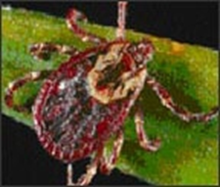
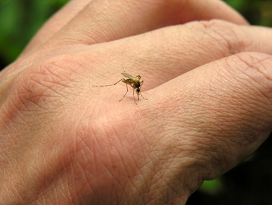
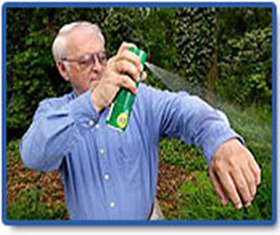
Insect-borne viruses & bacteria
Vector-borne illness
  West Nile Virus (horses and humans mostly, by mosquito)
  Rocky Mountain Spotted Fever (tick)
  Lyme Disease (tick)
Control measures
  Interrupt insect life cycle
  ID insect habitats
  Remove standing water to prevent mosquito breeding grounds (tip & dump)
  Apply insecticide to breeding areas (or self, when going outside).

Slide 15
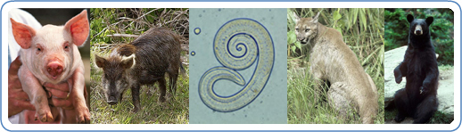
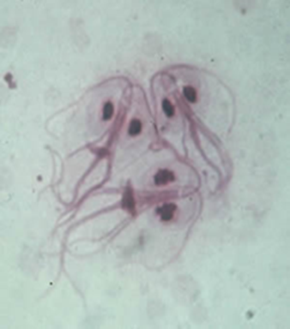
Parasites
Trichinella
Trichinellosis, also
called trichinosis, is
caused by eating raw
or undercooked meat of animals infected with the larvae of a species of worm called Trichinella.
(Symptoms: headache, abdominal pain, encephalitis)
Giardia
People become infected with Giardia by
swallowing Giardia cysts (hard shells containing Giardia) found in contaminated food or water.
The hard shells dissolve in the stomach , and larva attach to the intestines.

Slide 16
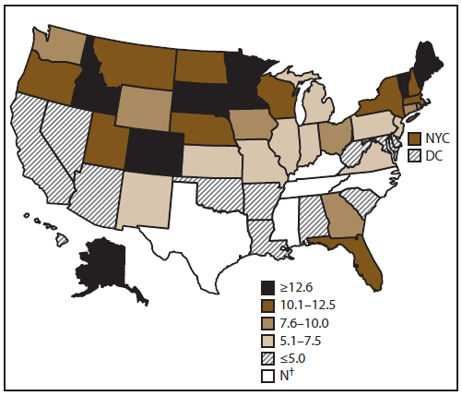
Incidence* of giardiasis, by state/area — National Notifiable Diseases Surveillance System, United States, 2010

Slide 17
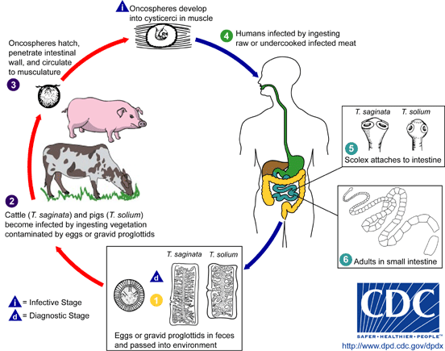
Parasites (continued)
Parasitic worms
tapeworms
roundworms
pinworms
Control measures:
  Follow strict de-worming schedule for all livestock and domestic pets
  Eat only thoroughly cooked meat.

Slide 18
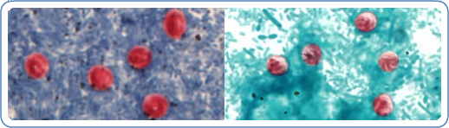
1. Do not drink from untreated water sources.
2. Have drinking water well tested.
Cryptosporidium-causes diarrhea

Slide 19
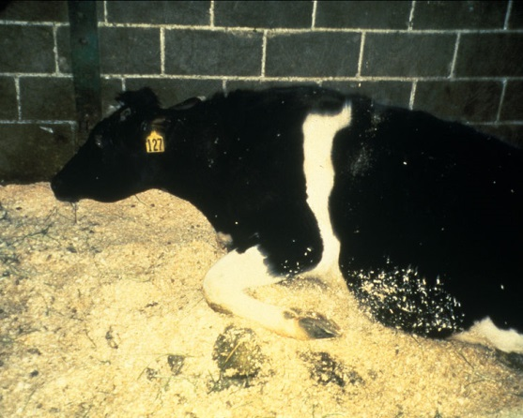
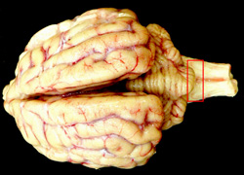
Mad Cow Disease
[Photo: Brain. The red box indicates the region of the obex, which is the portion of the brain that must be obtained for the diagnosis of BSE and other spongiform encephalopathies such as scrapie and chronic wasting disease. Source: Dr. S. Sorden, Iowa State University, College of Veterinary Medicine, Department of Veterinary Pathology/CFSPH]
Caused by prion
(proteinaceous infectious particle)
1996: emergence in humans in variant form as
Creutzfeldt-Jakob disease (vCJD), a
progressive dementia sourced to bovine
spongiform encephalopathy (BSE)

Slide 20
Thrive in spite of zoonotic disease:
Regular veterinary care will help protect your livestock, your pets, and your family.
Dispose of manure by best management practices.
Wash your hands frequently, especially after touching animals, and avoid contact with animal feces.
Follow proper food-handling procedures to reduce the risk of transmission from contaminated food.
For people with weakened immune systems, be especially careful of contact with animals that could transmit these infections.
Wash all raw fruits and vegetables before consuming them.
Apply bug repellent when going outside.

Slide 21
Sources:
http://www.cdc.gov/parasites/animals.html
http://onehealthkansas.k-state.edu/
http://www.cfsph.iastate.edu/DiseaseInfo/
disease-images.php
http://www.cfsph.iastate.edu/DiseaseInfo/
powerpoint.php
Contact information:
Martha Nowak, M.Ed
Program Coordinator for One Health Kansas
msnowak@ksu.edu
913/307-7321

Slide 22
Now for an activity…..
Divide into teams
CDC solve the Outbreak(use iPads) go to https://www.cdc.gov/mobile/applications/sto/

Slide 23

Contact:
Martha Nowak, M.Ed., K-12 Engagement Coordinator
K-State Olathe msnowak@ksu.edu
Questions?

